Slide 1
Orbital Debris Redirection and Thermal Re-entry
D.O.T.T.S.
(Debris Orbital Tumbler and Thermal Sensor)
Integrated Subsystem Testing Review
Arapahoe Community College, Community College of Aurora, and Red Rocks Community College
Notes:
‹#›
Those responsible for presenting:
Those responsible for content:
Notes:

Slide 2
Presentation Outline
Section 1: Mission Concept and Interfaces
Design Overview, Subsystem Testing and Integrated Subsystem Testing
Section 2: Mechanical
Section 3: Electrical
Section 4: Software
Section 5: Plan for FMSR
Section 6: Project Schedule
Section 7: Project Management
Section 8: Conclusion

Slide 3
1.0 Mission Concept and Interfaces
Ian McComas

Slide 4
Mission Overview
Mission Statement:
Our mission is to develop a concept toward a cost effective method for de-orbiting space debris that is too small to be tracked from Earth. Our secondary experiment’s mission is to find more cost-effective materials for future experiments/projects in space that can sustain the effects of re-entry into Earth’s atmosphere.
Objective:
1) We intend to determine the reliability of using electrostatic forces to interact with simulated space debris. 2) Catalogue the impact of thermal energy on low-cost test materials during re-entry. This will help us determine the most durable and cost effective materials to be used in future space flight.
Benefits:
Space debris will continue pose significant problems or failures to current and future space mission planned by the aerospace community. Cleaning up debris is imperative to ensure successful and safe missions. Also, aerospace communities could benefit greatly by obtaining collected data on thermal re-entry and its effects on 3D-printed materials allowing for less expensive space missions.
Why we should fly:
If chosen the data collected from D.O.T.T.S. could lead to a cleaner space environment, and provide data for reliable cost efficient material for future space flight.
Notes:
Content: Jack

Slide 5
Success Criteria (Primary)
Minimum Success Criteria:
Generate Static-Electric Field.
Eject Debris at apogee.
Record experiment data via video.
Comprehensive Success Criteria:
Use of photogate sensors to calculate debris velocity.
Record particle trajectory change with video overplotting onto a grid system.

Slide 6
Success Criteria (Secondary)
Mission Success Criteria:
Switch over to on-board power supply prior to re-entry.
Record and collect thermal re-entry data.
Environment temperature and internal temperatures.
Comprehensive Success Criteria:
Record/collect thermal changes with respect to time to determine which materials are most suitable for re-entry.

Slide 7
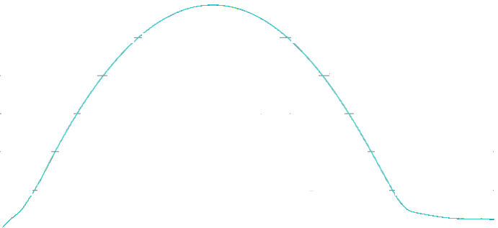
ConOps: Events Timeline
t ≈ 420 sec
Altitude: ≈ 110 km
Shutdown of Primary experiment systems
(Primary experiment concludes)
[Event D]
t ≈ 102 sec
Altitude: ≈ 110km
Rocket Despun
Deployment activation signal Signal to switch to internal battery for thermal experiment.
[Event B]
t ≈ 480 sec
Altitude: 95 km
Thermal Sensor (Secondary Experiment)
Apogee
t ≈ 174 sec
Altitude: ≈150 km
Material Ejected
[Event C]
t ≈ 90 sec
Altitude: 95 km
Thermal sensors are still powered during flight (Telemetry data) [Event A]
-Data Collection ongoing for thermal experiment
-Cut off from rocket power, on seperate power supply
-Data Collection Stage for Primary experiment
-Telemetry in full effect
t ≈ 600 sec
Chute Deploys
[Event F]
End of Malemute Burn
t ≈ 10 sec
Altitude: 52 km
Power to 5V converter to boot and run all Primary Experiment Boards and Cameras
t = -300 sec
Power to thermal experiment
t ≈ 900 sec
Splash Down
Thermal Sensor Shutdown
2019
14
Notes:
Those responsible for presenting:
Those responsible for content: SAME
Notes:

Slide 8
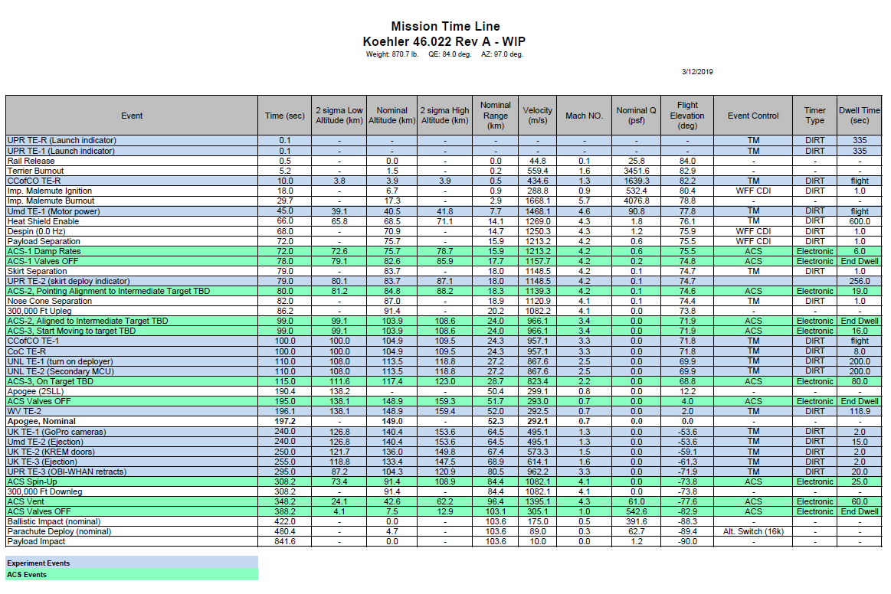
Mission Timeline

Slide 9
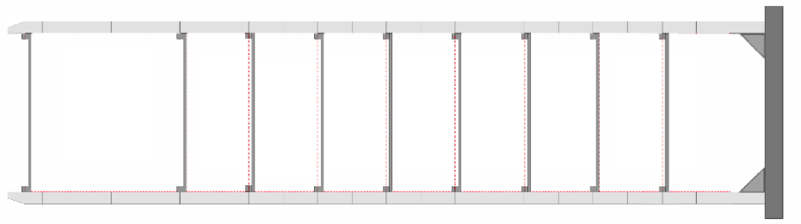









Payload Location
Notes:
Those responsible for presenting:
Those responsible for content: DONE
Notes:

Slide 10
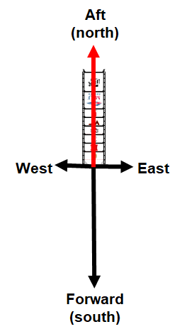
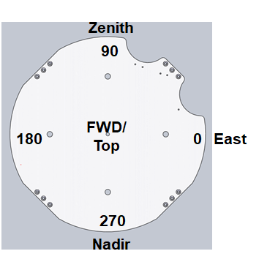

Pointing Request
Notes:
DONE

Slide 11
Timer Event Matrix
Event | Time On | Dwell | Event Description
GSE 1 | T= -300 sec | Flight | Power thermal experiment until(TE-2)
TE-R | T = 10 sec | Flight | Power to 5V converter to boot and run all Primary Experiment Boards and Cameras
TE-1 | T= 100 sec | Flight | A) Deployment activation signal B)Signal to switch to internal Battery for Thermal Experiment
2019
Notes:
Those responsible for presenting:
Those responsible for content: Same
Notes: Same?

Slide 12
Activation Sequence: CCofCO and UMd
 | School | Start (sec only) | Start (min, sec) | Dwell (sec) | End (sec only) | End (min, sec) | Comments
GSE 1 | CCofCO | T-300s | T-5min | Flight | Flight | Flight | Power thermal experiment (until battery is activated with TE-2)
GSE 2 | WV | T-180s | T-3min | Flight | Flight | Flight | Start on the computer for the experiments
TE-R | CCofCO | T+10s | T+0min, 10s | Flight | Flight | Flight | Power to 5V converter to boot and run all primary experiment boards cameras
TE-1 | CCofCO | T+100s | T+1min, 40s | Flight | Flight | Flight | Deployment activation signal, signal to switch to internal battery for thermal experiment
TE-2 | WV | T+196.1s | T+3min, 20s | 118.9s | T+315 | T+5min, 15s | Launch Suborbital Reentry Payload at apogee, WVU antenna deploy
TE-3 | WV | TBD | TBD | TBD | TBD | TBD | TBD
Notes:
Those responsible for presenting:
Those responsible for content: DONE
Notes: Don’t change

Slide 13
Pin Assignments: Power
Power Connector--Customer Side
Pin | Function
1 | GSE 1
2 | Timer Event Redundant (TE-RA)
3 | Timer Event Redundant (TE-RB)
4 | Timer Event 1(TE-1)
5 | GND
6 | GND
7 | GND
8 | GND
9 | N/A
10 | N/A
11 | N/A
12 | N/A
13 | N/A
14 | N/A
15 | N/A
Notes:
Those responsible for presenting:
Those responsible for content: Ruby
Notes:

Slide 14
Pin Assignments: Telemetry
Telemetry Connector--Customer Side
Pin | Function | Pin | Function
1 |  | 20
2 |  | 21
3 |  | 22
4 |  | 23
5 |  | 24
6 |  | 25
7 |  | 26
8 |  | 27
9 |  | 28
10 |  | 29
11 |  | 30
12 |  | 31
13 |  | 32 | RS-232 Data (sharing w/UMd)
14 |  | 33 | RS-232 GND (sharing w/UMd)
15 |  | 34
16 |  | 35
17 |  | 36
18 |  | 37
19
Notes:
Those responsible for presenting:
Those responsible for content: Ruby
Notes: Don’t delete who we are sharing with please

Slide 15
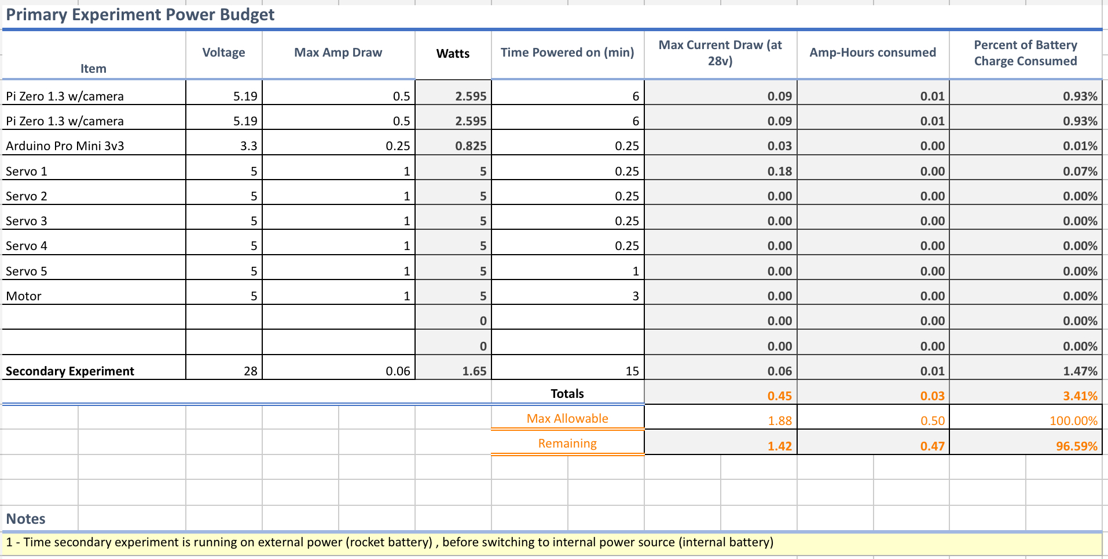
Updated Power Budget
Notes:
Those responsible for presenting:
Those responsible for content: Rhiannon
Notes:

Slide 16
Detailed Weight Budget
Subsystem | Weight (lbs)
Primary | 3.4
Secondary | 2.1
Electronics | 0.76
Other Systems (Electronics Box, Wiring Bay, etc.) | 0.61 (Estimated to increase when insulation added to components)
Total (Max 15lbs) | = 6.87 + 3.425(deck) = 10.295
Notes:
Those responsible for presenting:
Those responsible for content: Bruce
Notes: Complete!

Slide 17
System Changes Since STR
Primary
The static charge generator has been slightly modified to allow for more surface area contact of the rabbit fur to the polycarbonate sheet. This will create a greater static field for maximize results. This does not change the mission statement.
Secondary
The mount for the 3D printing materials will be mounted to a wall like structure. This design allows for full exposure of the material and provides more room for other components. This does not change the mission statement.
Notes:
Those responsible for presenting:
Those responsible for content: Bruce
Notes:

Slide 18
2.0 Mechanical
Design Overview, Subsystem Testing, and Integrated Subsystem Testing Status
Dallas McKeough
Notes:
Those responsible for presenting:
Those responsible for content:
Notes:

Slide 19
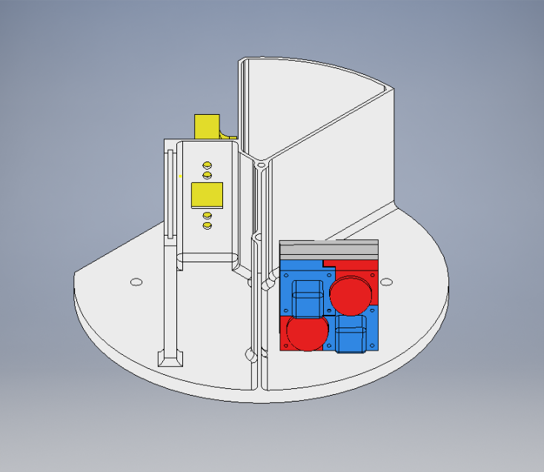
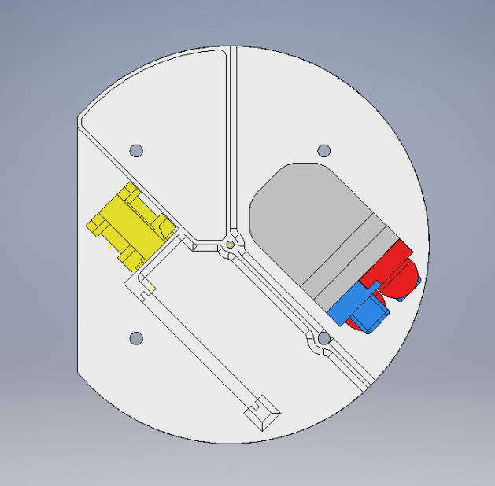
Design Overview (System)
Electronics compartment (will be sealed for flight)
Entire payload layout
Launcher and Camera Mount
Placement of Charge Generator. (Rabbit fur, motor and servo)
Secondary Experiment
Debris Trajectory
Notes:
Those responsible for presenting:
Those responsible for content: MECHANICAL TEAM
Notes:

Slide 20
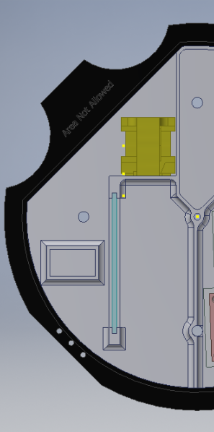
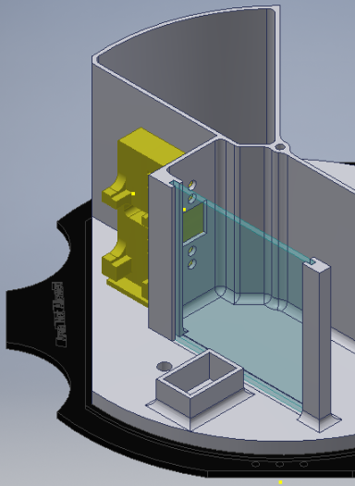
Design Overview (Primary)
Primary Design
Launcher
The primary design has not been altered since the previous iteration in concept. The clear blue film in the images will be charged via friction induced by rabbit fur on a motor. This is accompanied by the launcher mechanism which will deploy debris parallel to this film, allowing us to collect data on the debris’ trajectory in relation to the charged film.
Camera Mount
Charged film
Motor mount for charge generator
Debris’ Launch Trajectory
Notes:
Those responsible for presenting:
Those responsible for content: MECHANICAL TEAM
Notes:

Slide 21
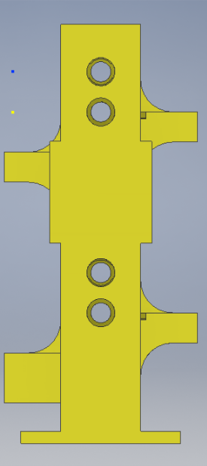
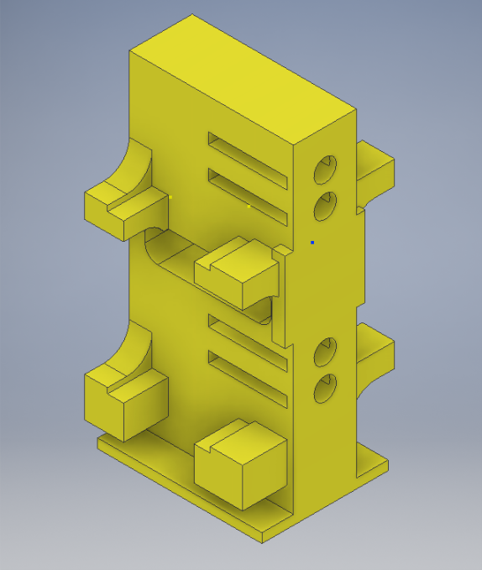
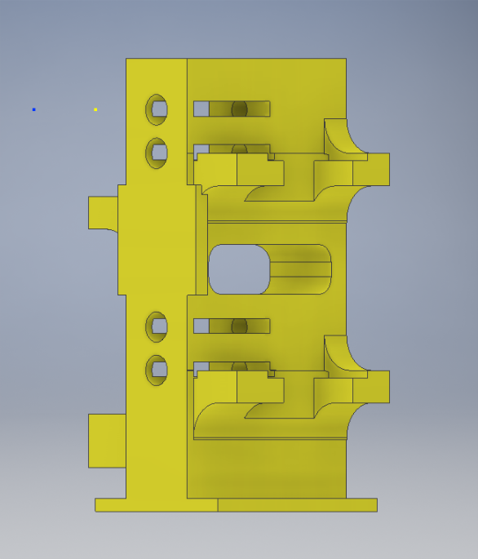
Design Overview (Primary)
Launching Mechanism
The full launching mechanism consists of one solid shape that will house four servos, four pieces of simulated debris and a camera for data. Current deployment velocity is 1 in/s
Camera Mount
Debris Launch Barrel
Servo Mounting Ledge
Notes:
Those responsible for presenting:
Those responsible for content: MECHANICAL TEAM
Notes:

Slide 22
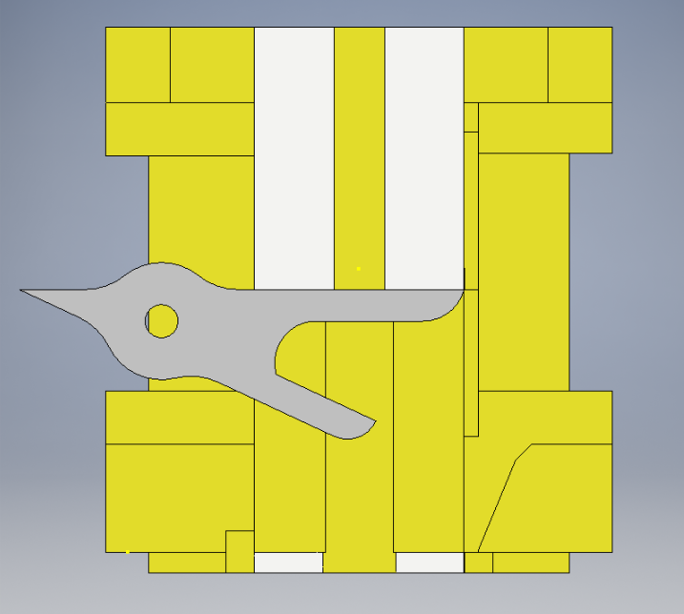
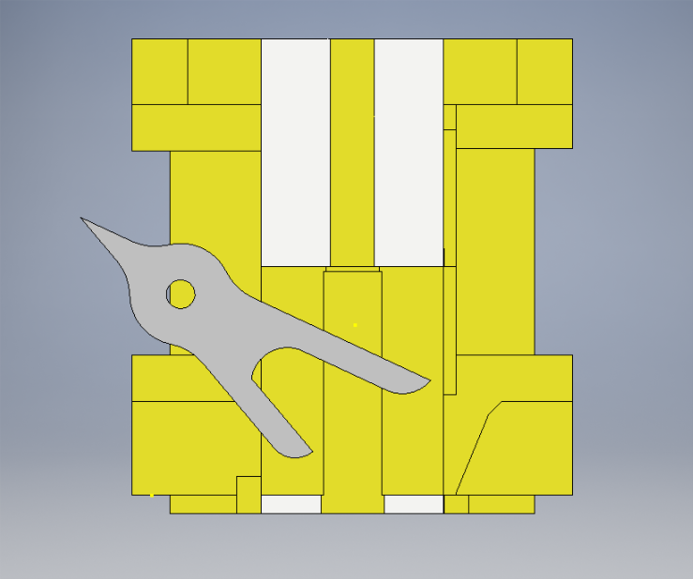
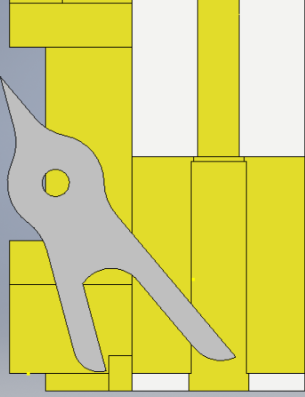
Design Overview (Primary)
Launching Mechanism
The simulated debris will be held in place during flight via the servo. Once the static charge is built and debris launch is ready to commence the servo motor will rotate to accelerate the ball out of the launcher.
Servo Motor
Simulated Debris
Launcher Barrel
Notes:
Those responsible for presenting:
Those responsible for content: MECHANICAL TEAM
Notes:

Slide 23
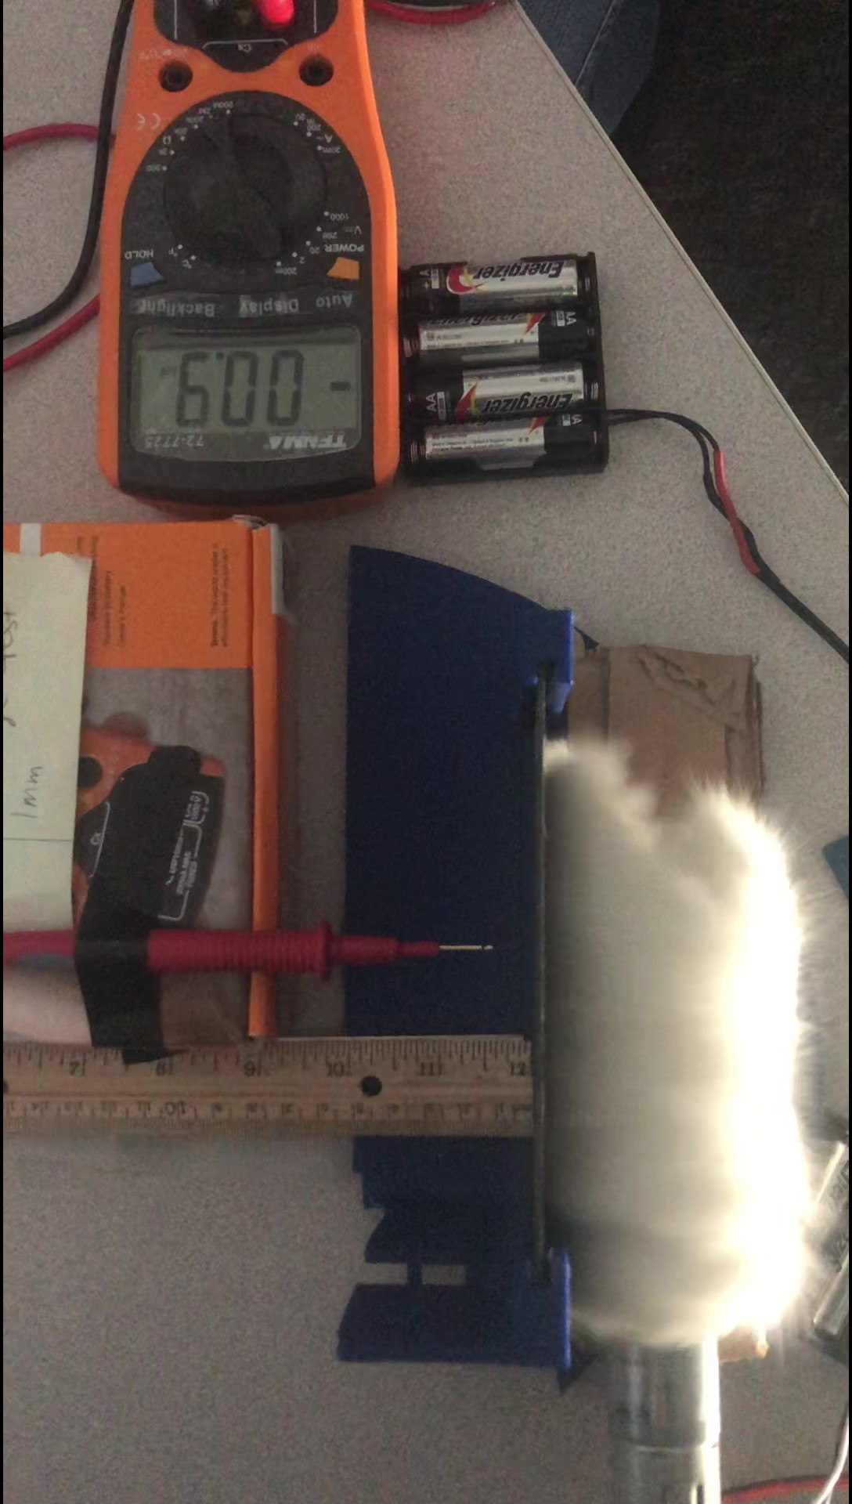
Design Overview (Primary)
Charging Mechanism
The charging mechanism is utilizes the same design, which produces a static charge via rabbit fur on a charge plate. The mechanism is a rabbit fur rod attached to a high torque motor mounted on a servo.
Mounted motor
Mechanism to turn rabbit fur
Charging Rabbit fur
Charge film
Notes:
Those responsible for presenting:
Those responsible for content: MECHANICAL TEAM
Notes:

Slide 24
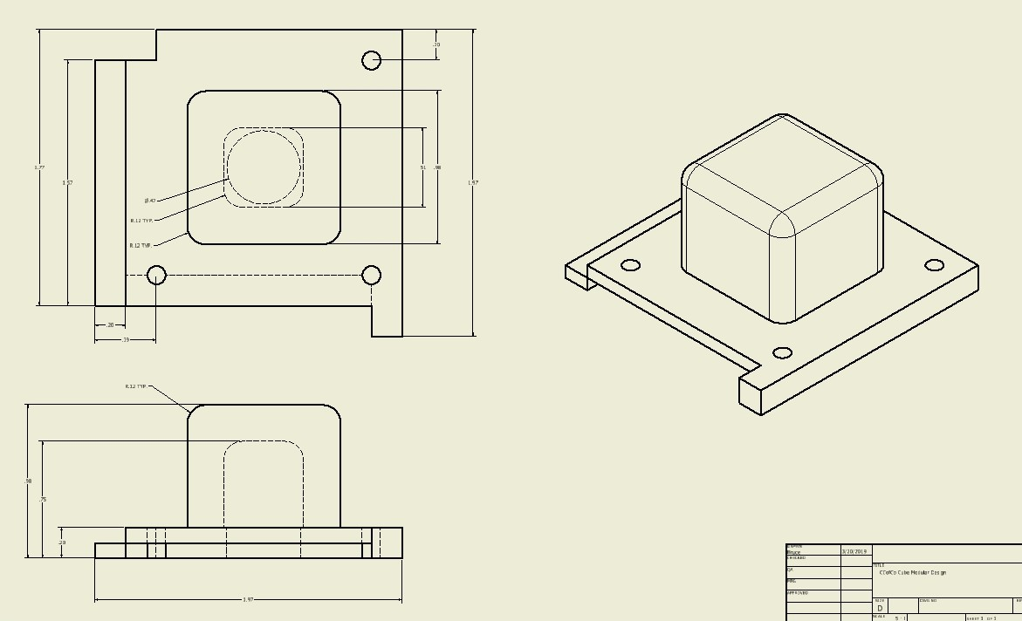
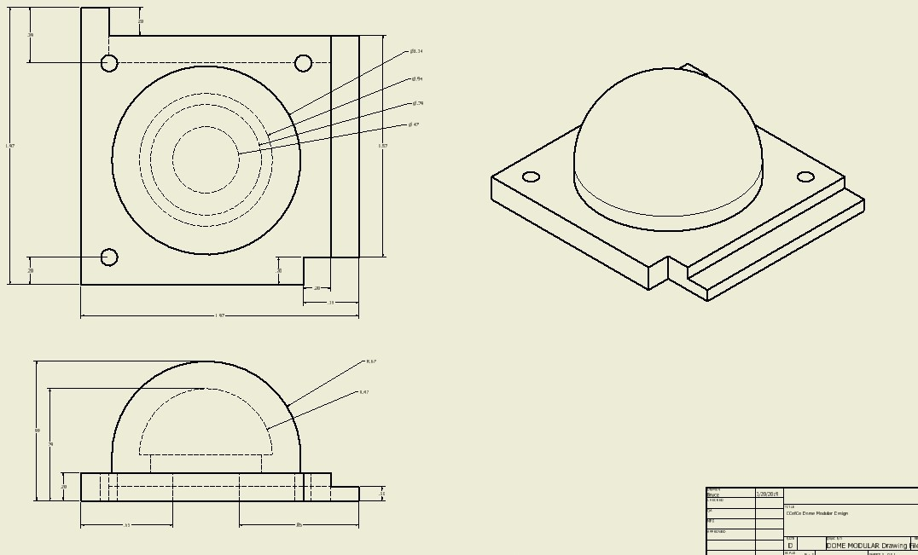
Design Overview (Secondary)
Thermal sensor mount
Mounting holes
Interlocking mounting
Base where fiberglass will mount on top
Each design has a hole in the center of the shape where the Temperature Sensors will seat. The base of each shape has an interlocking design that will allow for the four shapes to be mounted in unison. The base has screw holes to allow them to be bolted onto the payload. A fiberglass protective layer will then be put over top to protect from the heat.
Notes:
Those responsible for presenting:
Those responsible for content: MECHANICAL TEAM
Notes:

Slide 25
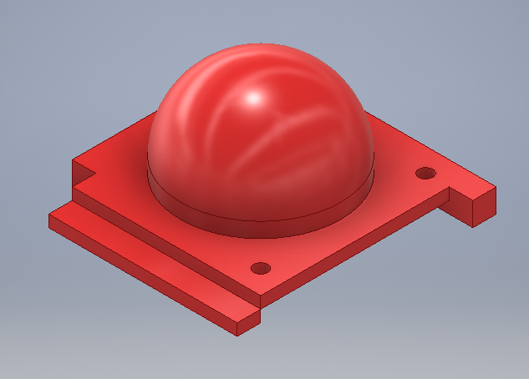
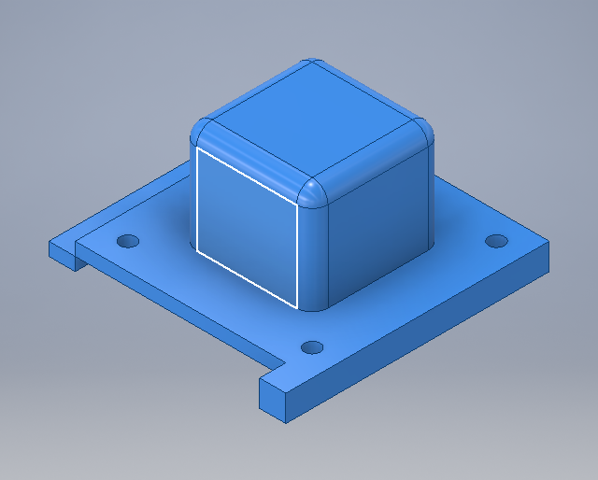
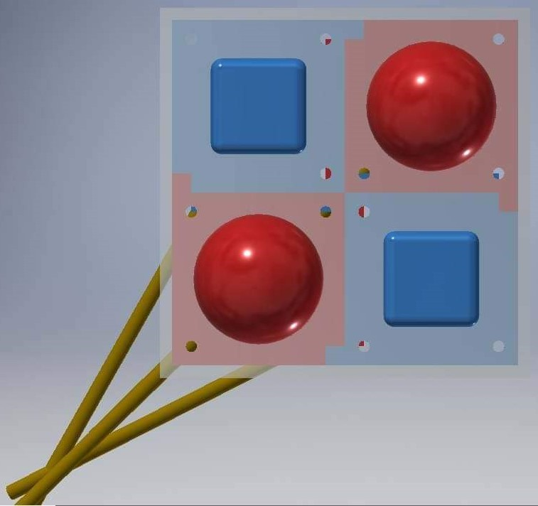
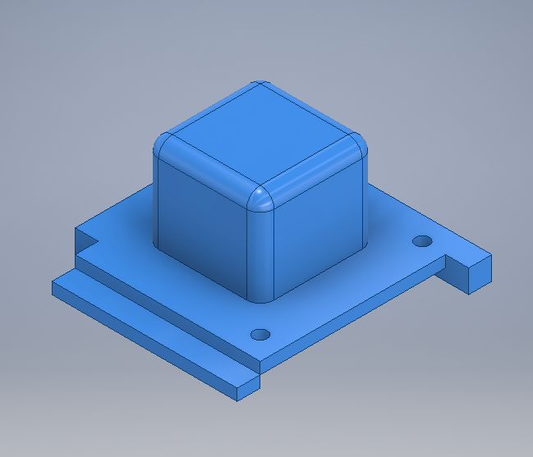
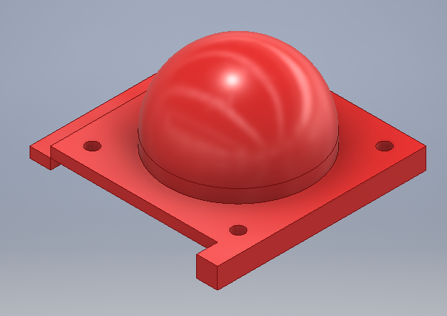
Design Overview (Secondary)
The four shapes will interlock and the base will be covered in a fiberglass mold to ensure the shapes stay mounted to the payload upon re-entry.
Notes:
Those responsible for presenting:
Those responsible for content: MECHANICAL TEAM
Notes:

Slide 26
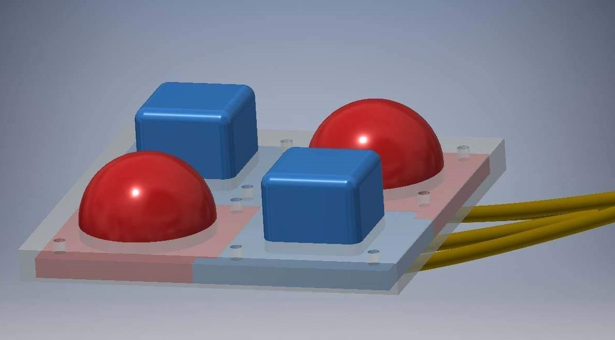
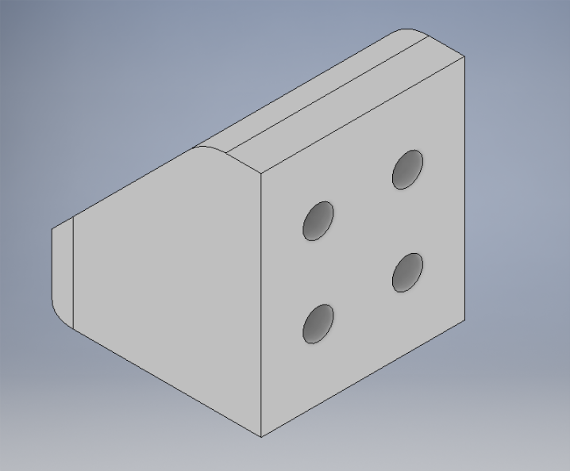
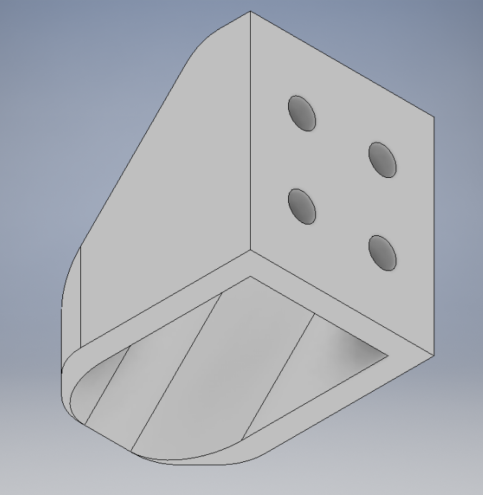
Design Overview (Secondary)
The four printed materials will be mounted to the wall design to allow for a full uniform exposure of re-entry environments on each shape. A thermal resistance material (fiberglass) will encase all structural supports to ensure safe flight.
Thermal sensor wiring hole
Thermal sensor wiring
Screw holes to be added to mount prints
Wiring tunnel for thermal sensor wires
Notes:
Those responsible for presenting:
Those responsible for content: MECHANICAL TEAM
Notes:

Slide 27
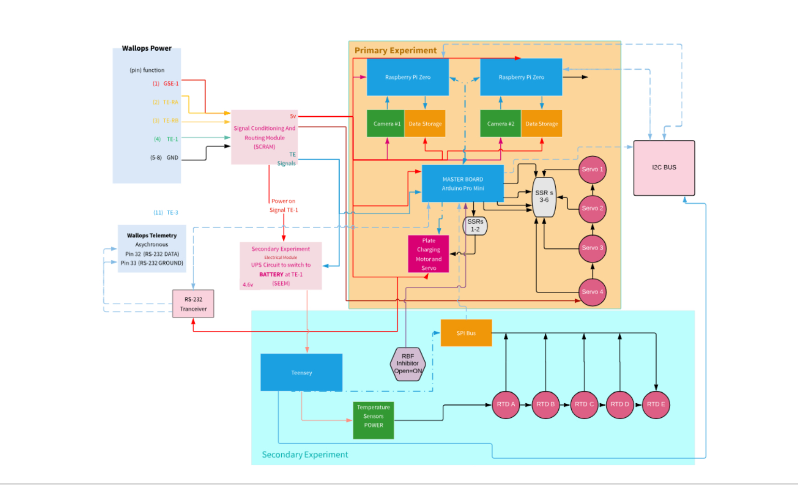
Functional Block Diagram

Slide 28
Hazardous Mechanical Items
Primary
Use of deployables
Current speed is less than 1 inch per second, further testing and implementations will provide accurate speed replicability.
Static Charge generator
Charge field is small and likely will not affect other experiments. Testing has shown that this should not be a concern.
Secondary
Battery for secondary power supply
Testing and insulation will ensure that the battery will be safe during flight.
Notes:
Those responsible for presenting:
Those responsible for content:
Notes:

Slide 29
Charging Plate Subsystem
Percent of Testing Completed
 |  | 50%
Required Tests | Purpose | Complete/ Incomplete
Vacuum Testing | To ensure that the charge mechanism will perform as anticipated in space | Complete
Shake/Stress Testing | To ensure that all components will survive the intense forces of ascend | Incomplete
Sealed Charging Chamber Testing | To ensure the charging subsystem can build charge in a vacuum environment | Incomplete
Static Field Voltage Testing | To measure the magnitude of the static field generated | Complete

Slide 30
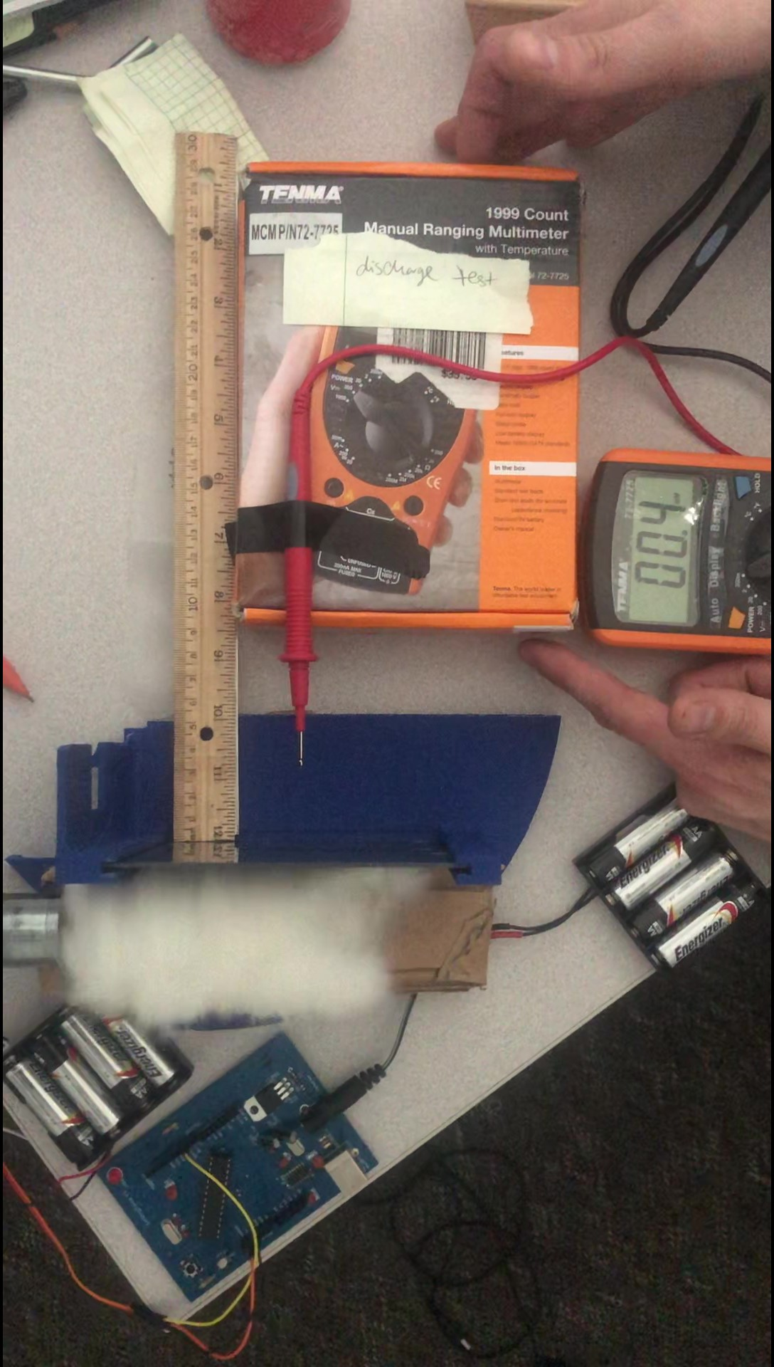
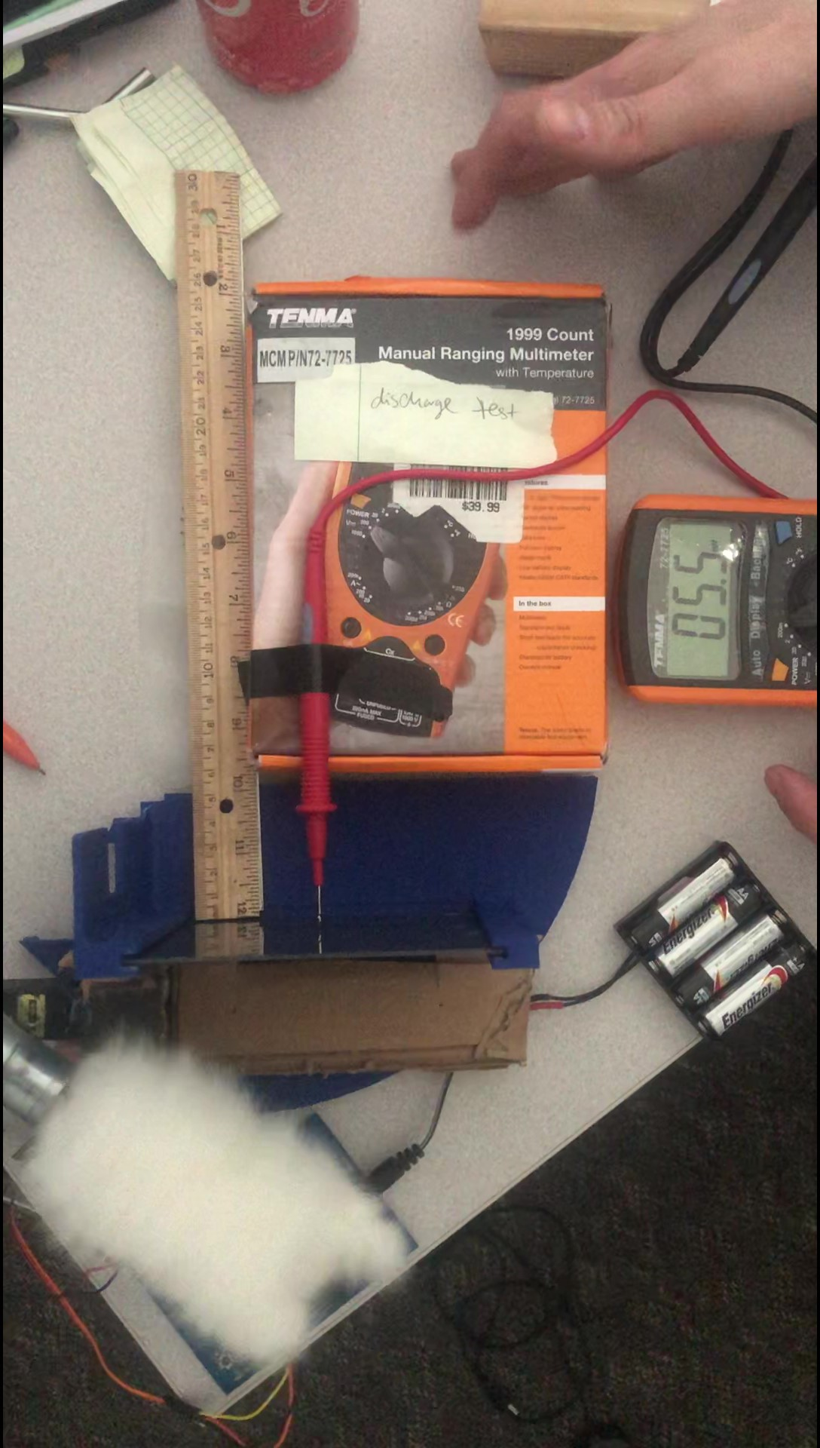
Charging Plate Subsystem
Testing Voltage Discharge
Results
A lower charge changing and present before contact.
A spike in voltage consistently occurred upon contact with the polycarbonate.
Spike range was between 3 mV (min) and 197 mV (max).
Average contact voltage reading around 10 mV.
Further data analysis underway.

Slide 31
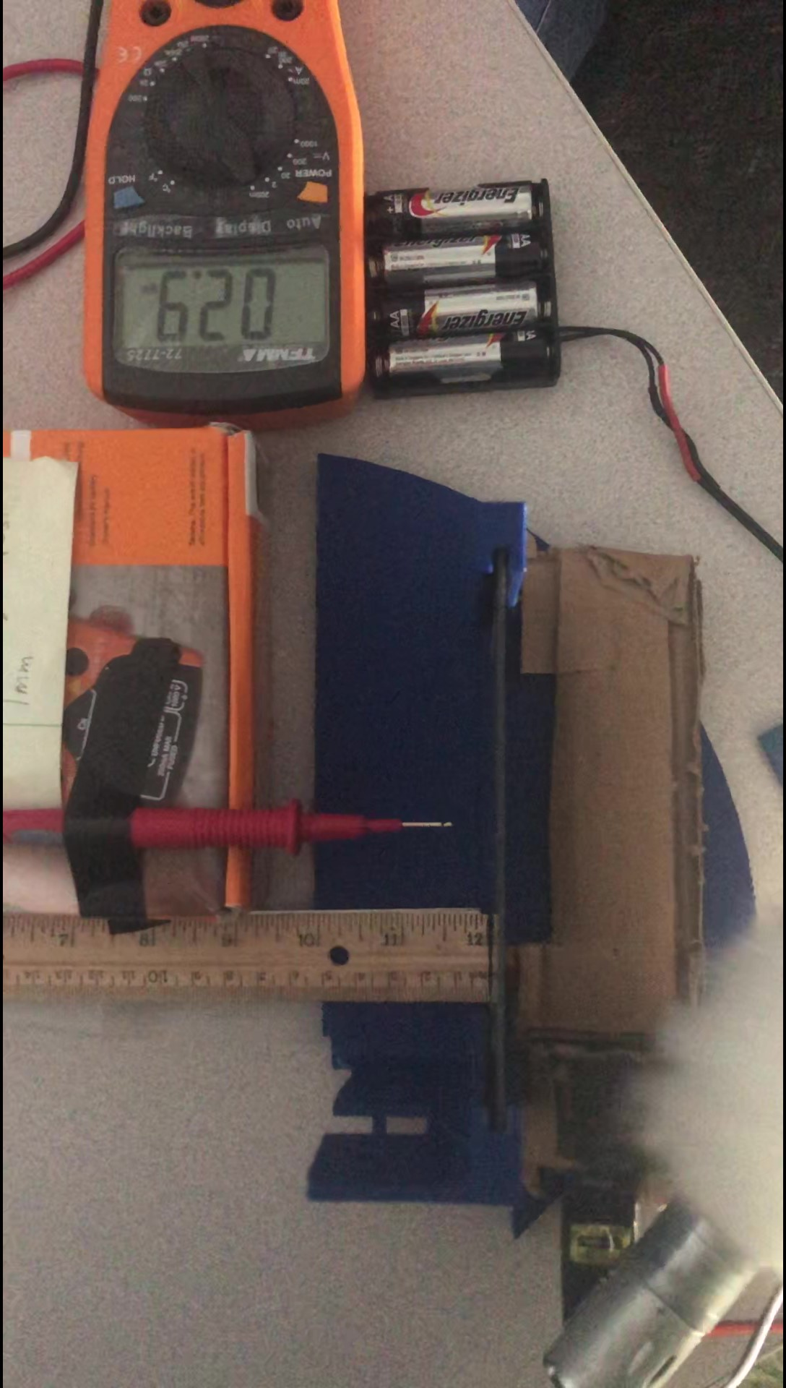
Charging Plate Subsystem
Static Field Voltage Testing (from 1cm away from plate)
Results
Found lower charges present when the charging apparatus was closer to the plate.
Voltage spike consistently present when charger position was fully away from polycarbonate plate.
Spike range was much smaller than contact testing.
Most common spikes ranged from 2-7 mV.
Further data analysis underway.

Slide 32
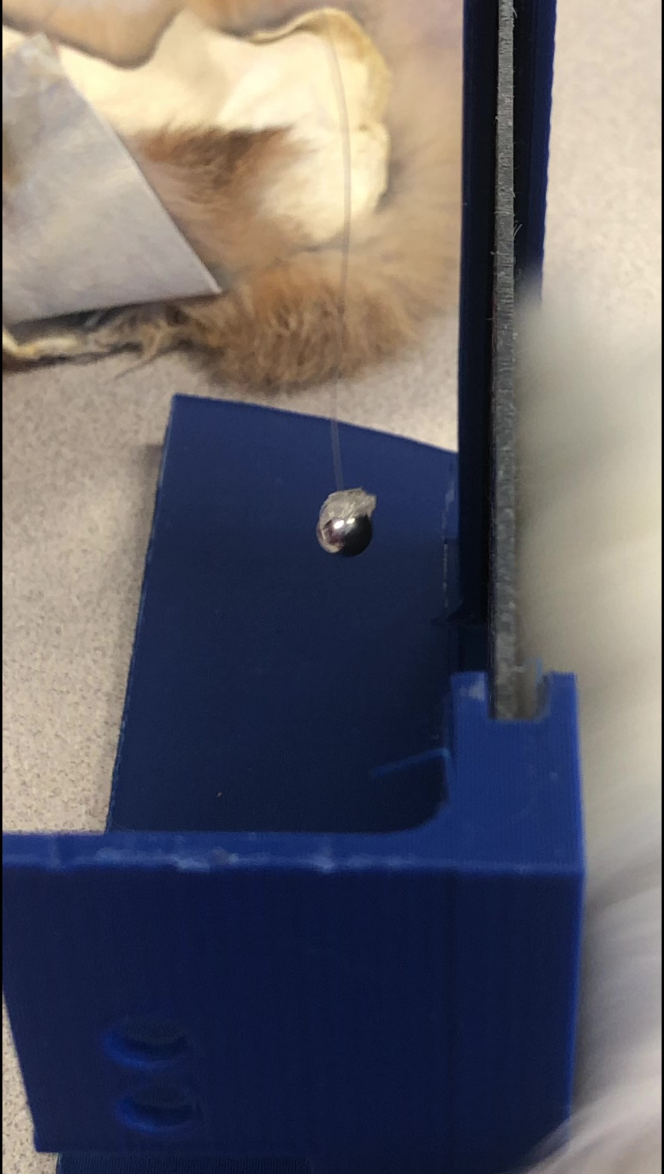
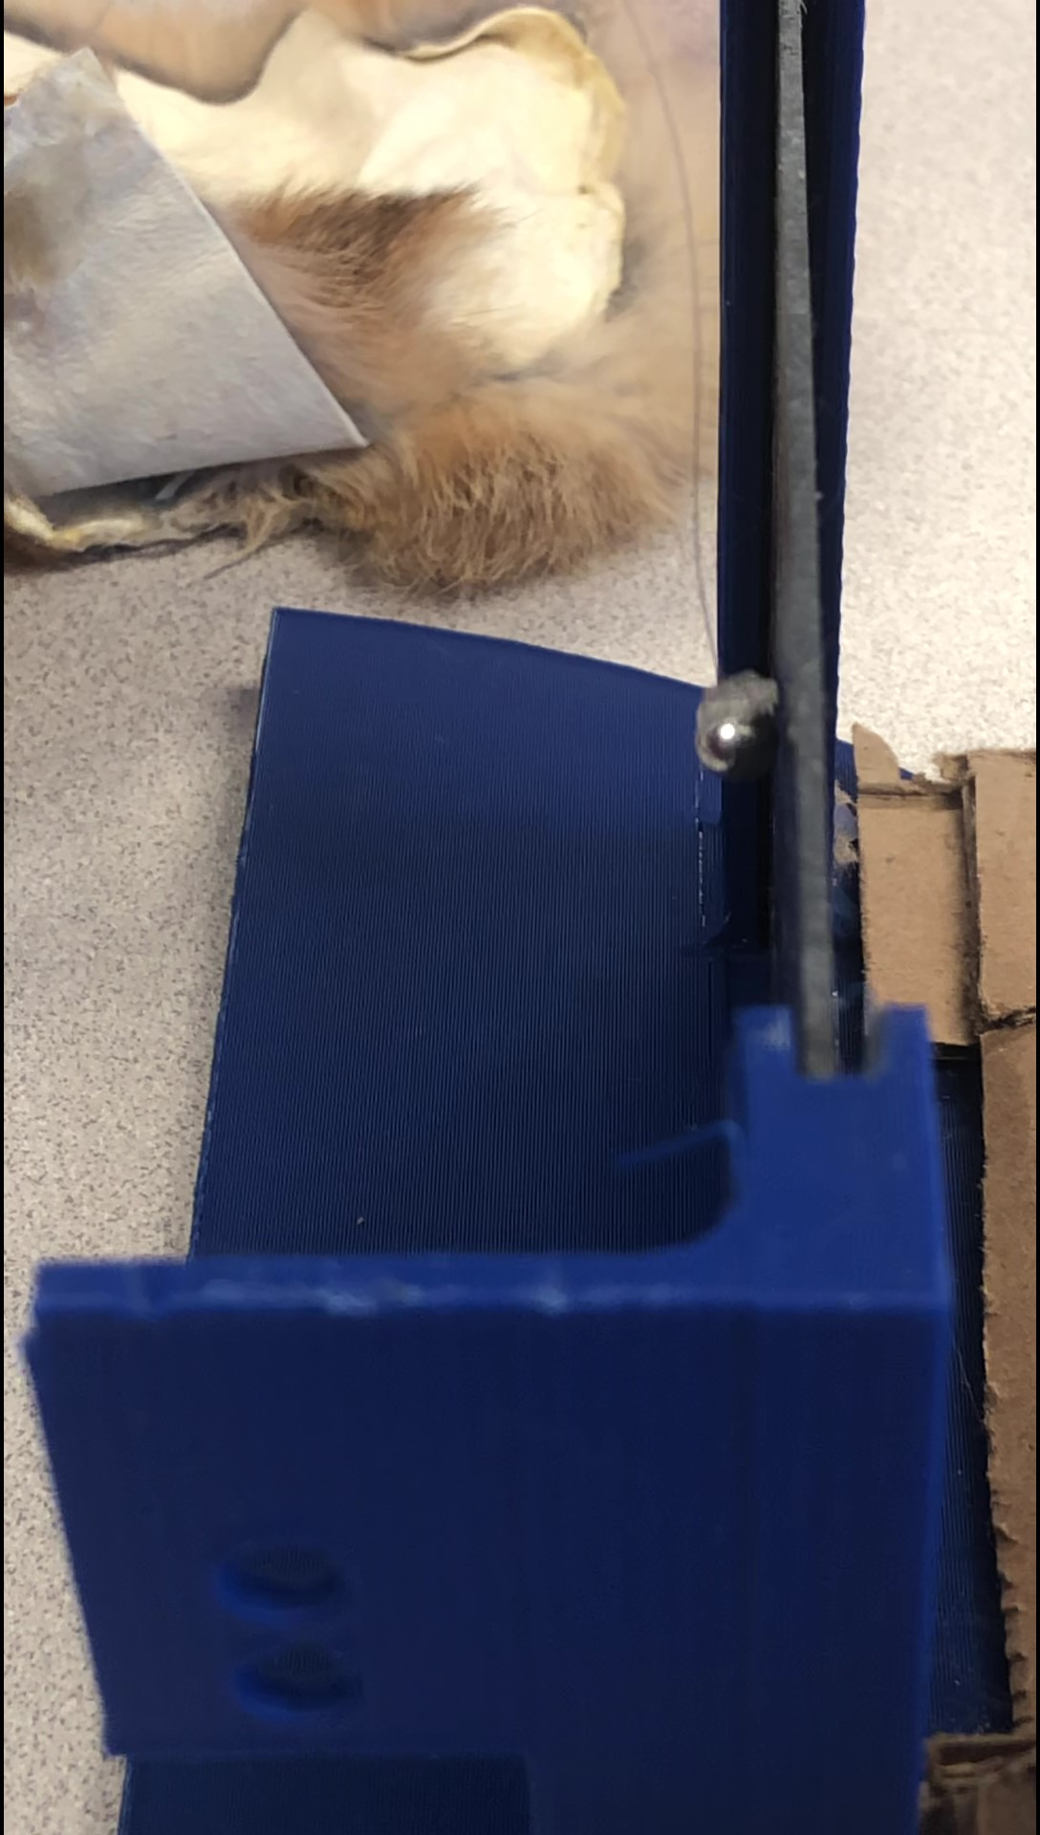
Charging Plate Subsystem
Aluminum Debris to Plate Attraction
Results
Aluminum debris showed attraction to the charged plate as the charging roller moved away.
Further analysis will determine the desired position of the charger in relation to the plate.

Slide 33
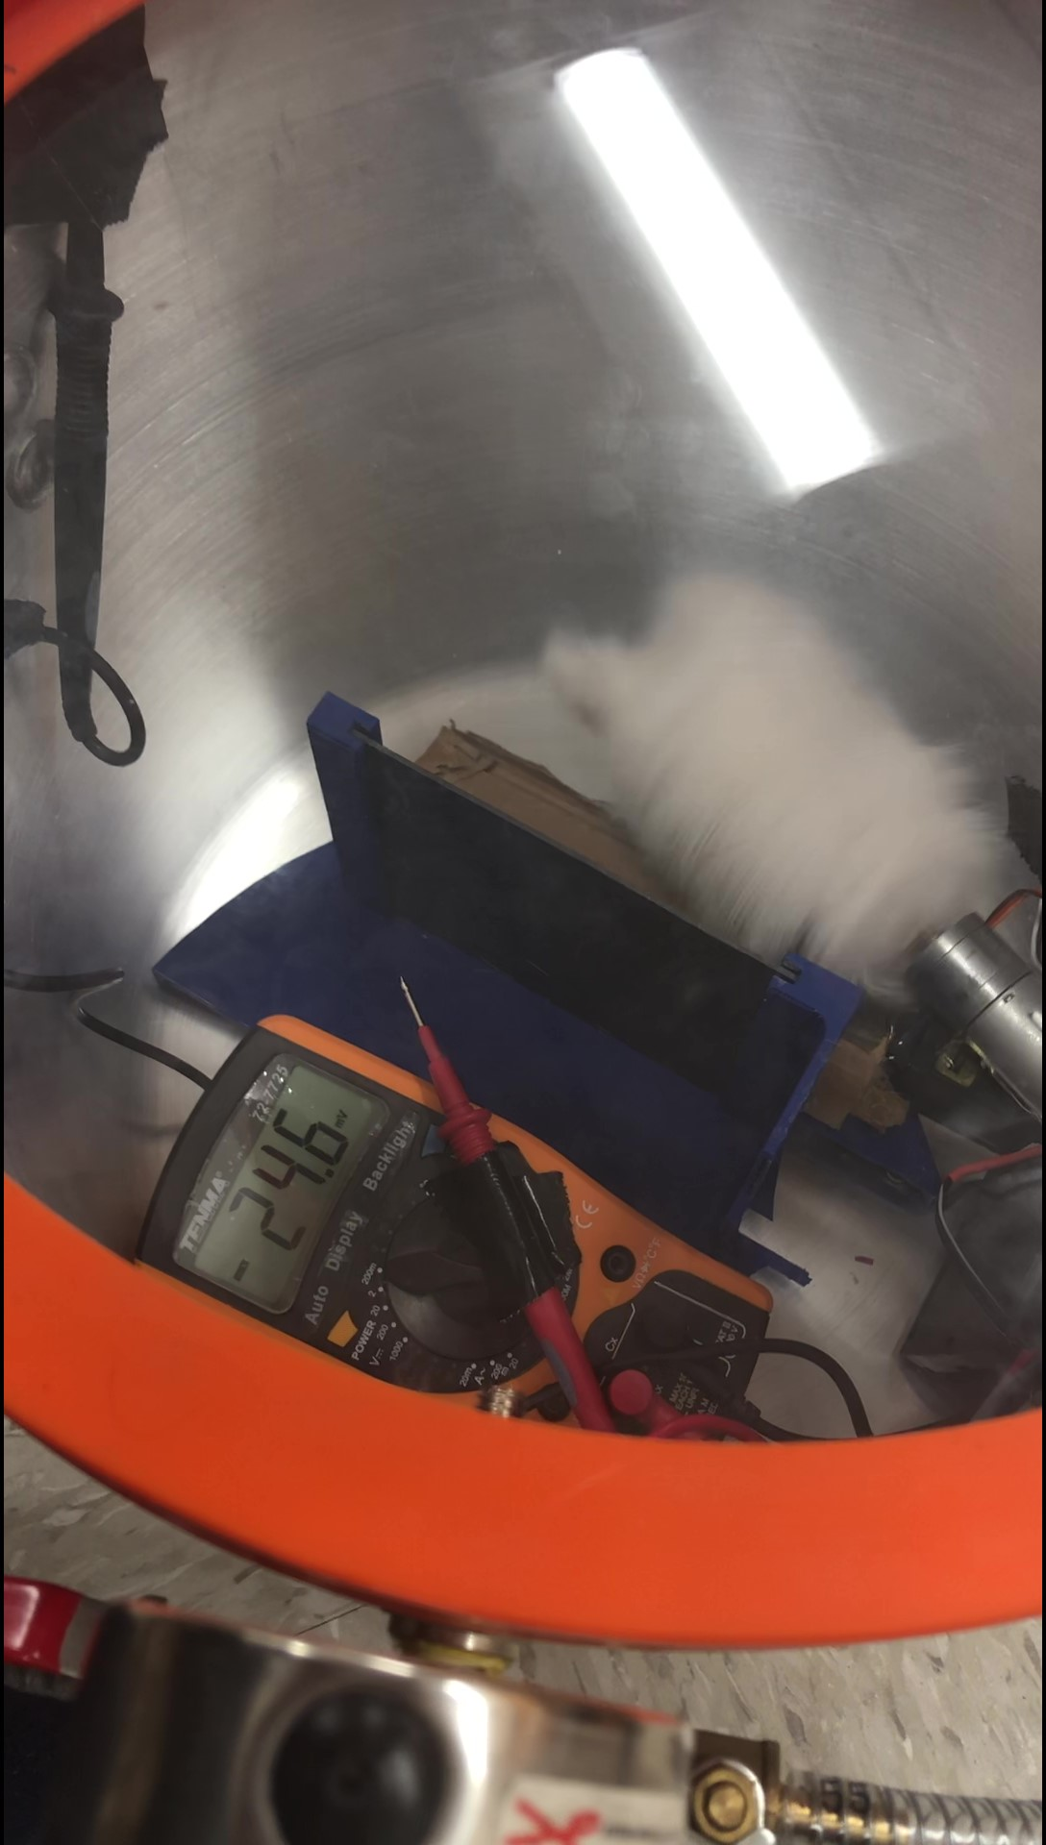
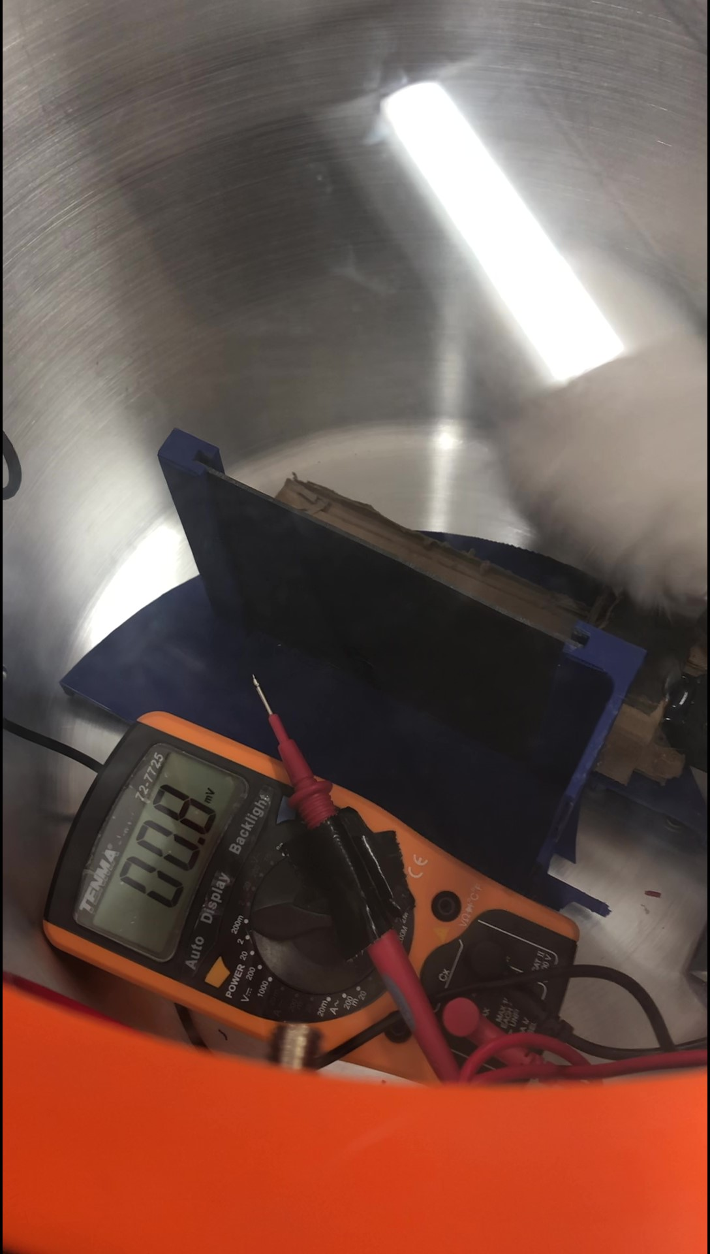
Charging Plate Subsystem
Before Vacuum
After Vacuum
Testing Charge in a Vacuum
Results
We were surprised to see the charge was consistently lower at the voltage peak within the vacuum than without the vacuum.
This suggested the need for air molecules during the charging process.

Slide 34
Charging Plate Subsystem
Future Testing Schedule
Closed Charging Chamber Testing
Vacuum Testing with Closed Chamber
April 12
April 26
April 5
April 19
Vibration Testing
Full system testing and Integration

Slide 35
Launcher Subsystem
Percent of Testing Completed
 |  | 80%
Required Tests | Purpose | Complete/ Incomplete
Vacuum Testing | To help ensure that all systems operate in space | Complete
Shake/Stress Testing | To ensure that the components will survive the intense effects of ascend | Incomplete
Camera Testing | Image recognition software to capture position of debris | Complete
Velocity Testing | To keep initial velocity of debris below 1 in/sec | More Testing Required

Slide 36
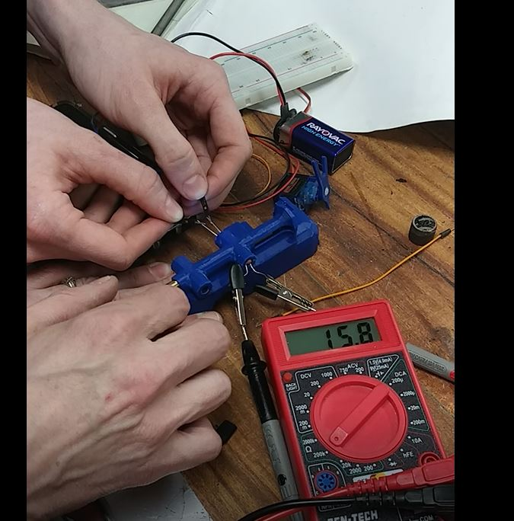
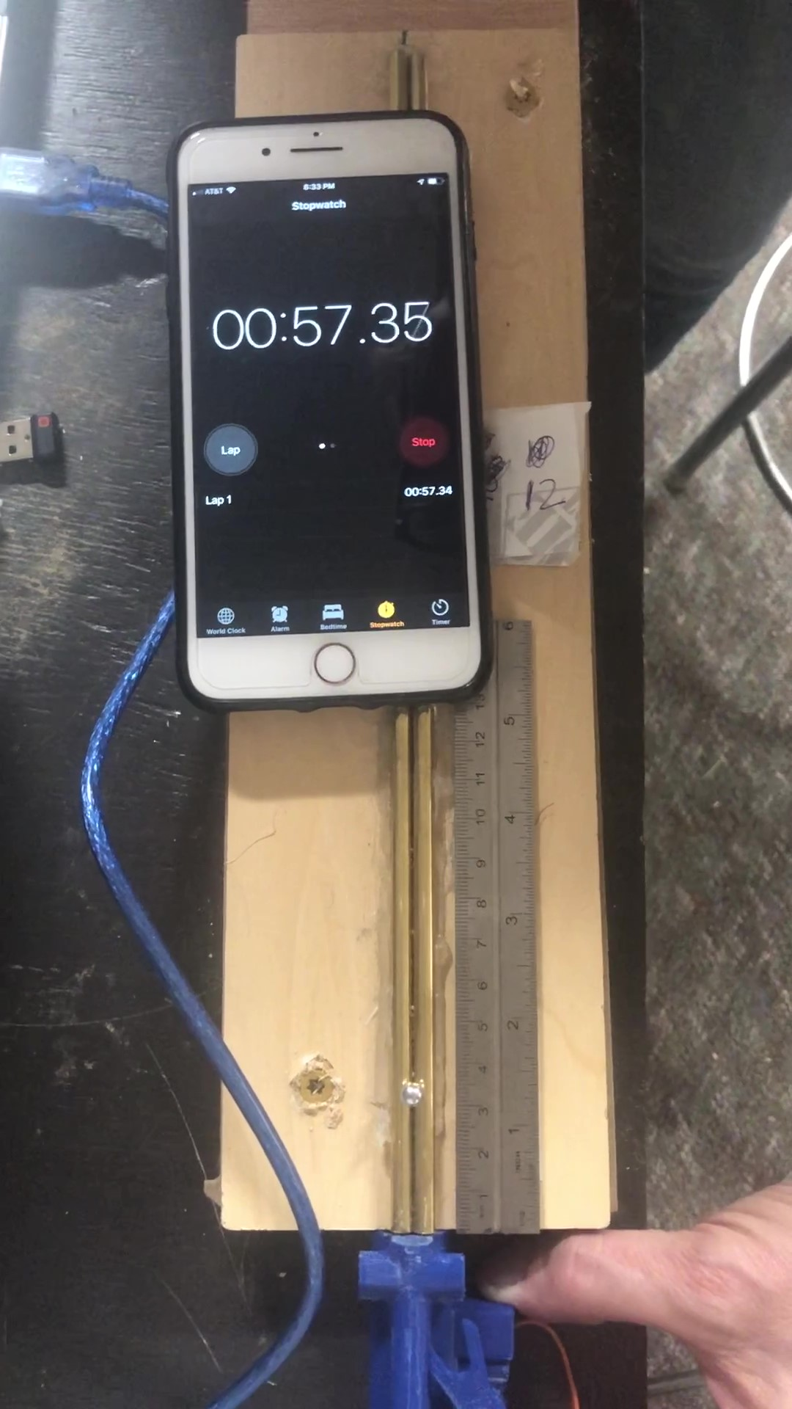
Launching System
Velocity Testing with Servo
Results between methods of measuring velocity of the debris were different.
The velocities measured with the photoresistor method were much faster than velocities measured with the video method.
A more controlled version of the photoresistor method has been designed for retesting.
A pressure sensor method is also being created as a third way to gather data on our velocity settings within the launcher.

Slide 37
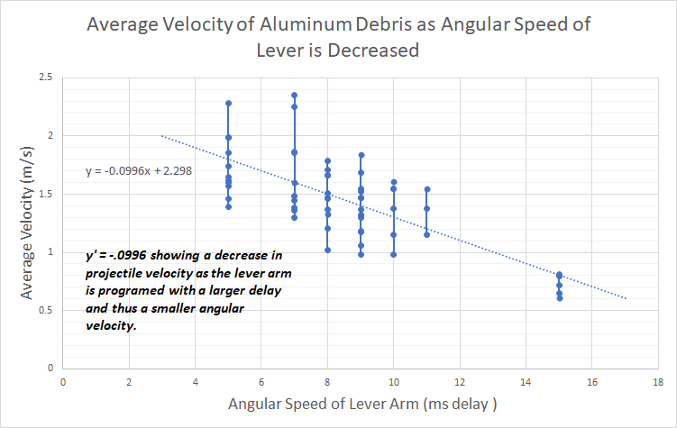
Launching System
We were able to confirm the trend of decrease in velocity as the delay value was increased.
Delay (ms) of Servo Lever | Average Velocity (in/s) | Average Deviation
5 | 1.739172 | 0.209786
7 | 1.688923 | 0.312359
8 | 1.470484 | 0.17641
9 | 1.37876 | 0.194263
10 | 1.369944 | 0.20079
11 | 1.358381 | 0.136744
15 | 0.732191 | 0.072734

Slide 38
Launcher Subsystem
Future Testing and Schedule
Velocity Control Tests
Camera Integration testing
April 12
April 26
March 29
April 19
Vibration Testing
Integration Testing with Launcher and Camera

Slide 39
Secondary Subsystem
Percent of Testing Completed
 |  | 75%
Required Tests | Purpose | Complete/Incomplete
Heating/Cooling Test | To ensure that the 3D print material will survive the effects of re-entry from initial descend to splash down. | Complete
Wind Tunnel Testing | To ensure that the material will survive the intense wind forces during re-entry | Incomplete
Vacuum Testing | To ensure the the material is porous enough to not burst during the change of state | Complete

Slide 40
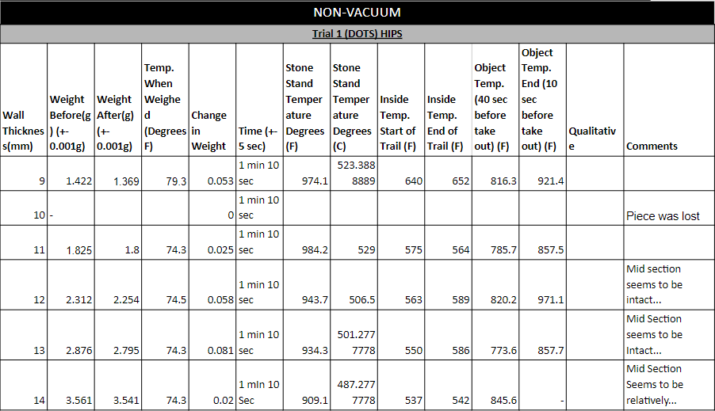
Secondary Subsystem
Recent Testing and Results
*Insert testing results from previous trials*

Slide 41
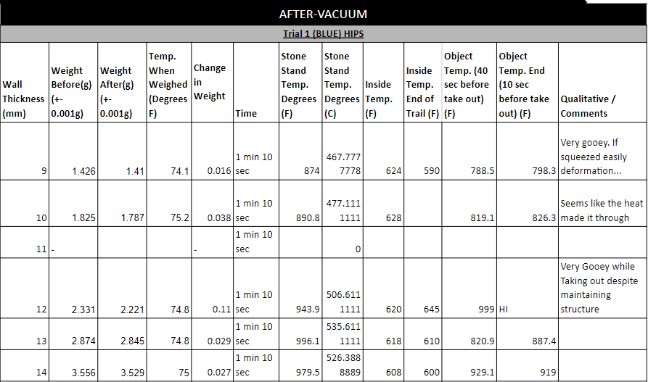
Secondary Subsystem
Recent Testing and Results
*Insert testing results from previous trials*

Slide 42
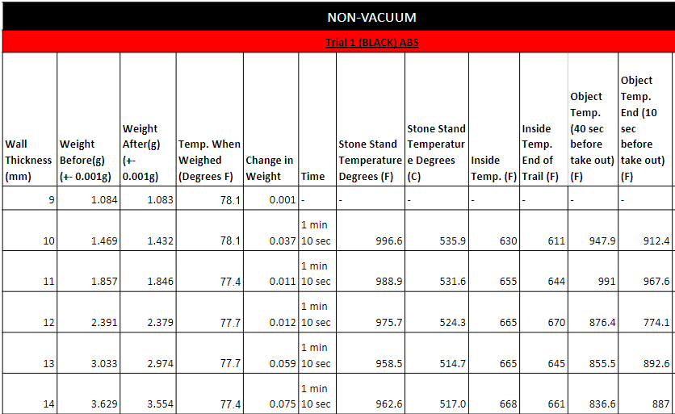
Secondary Subsystem
Recent Testing and Results
*Insert testing results from previous trials*

Slide 43
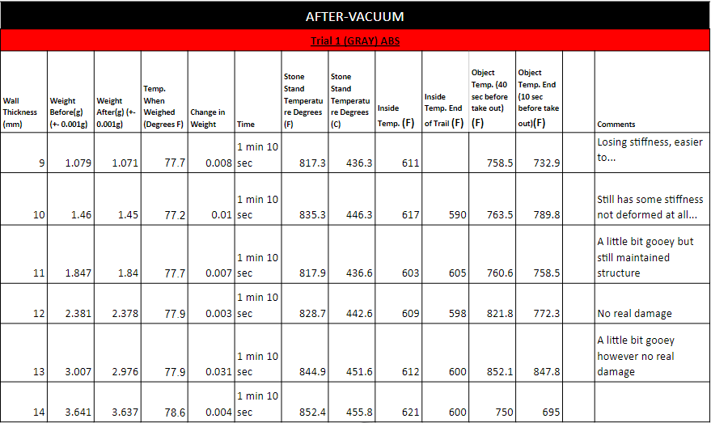
Secondary Subsystem
Recent Testing and Results
*Insert testing results from previous trials*

Slide 44
Secondary Subsystem
Wind Tunnel Testing
The wind tunnel testing will replicate the anticipated wind velocity and high temperature that the material will be subjected to during re-entry to ensure that the material will have a maximum chance of survival.
The current forge will be altered to allow for a high wind force to interact with the material while exposed to the intense heats.
Multiple trials of quantitative and qualitative testing will determine if the material will survive the forces.

Slide 45
Integrated Subsystem Testing
Percent of Integrated Subsystem Testing Completed
 |  | 70%
1
2
3
4
Launcher + Charging Plate
Camera + Launcher
Electronics + Software + Primary + Secondary
Will not function together properly without microgravity and vacuum of space.
Software + Secondary Materials
&
Software + Primary Subsystems
Image recognition software working and ready
Fine tune Primary and Secondary for final integration testing
Successful integration

Slide 46
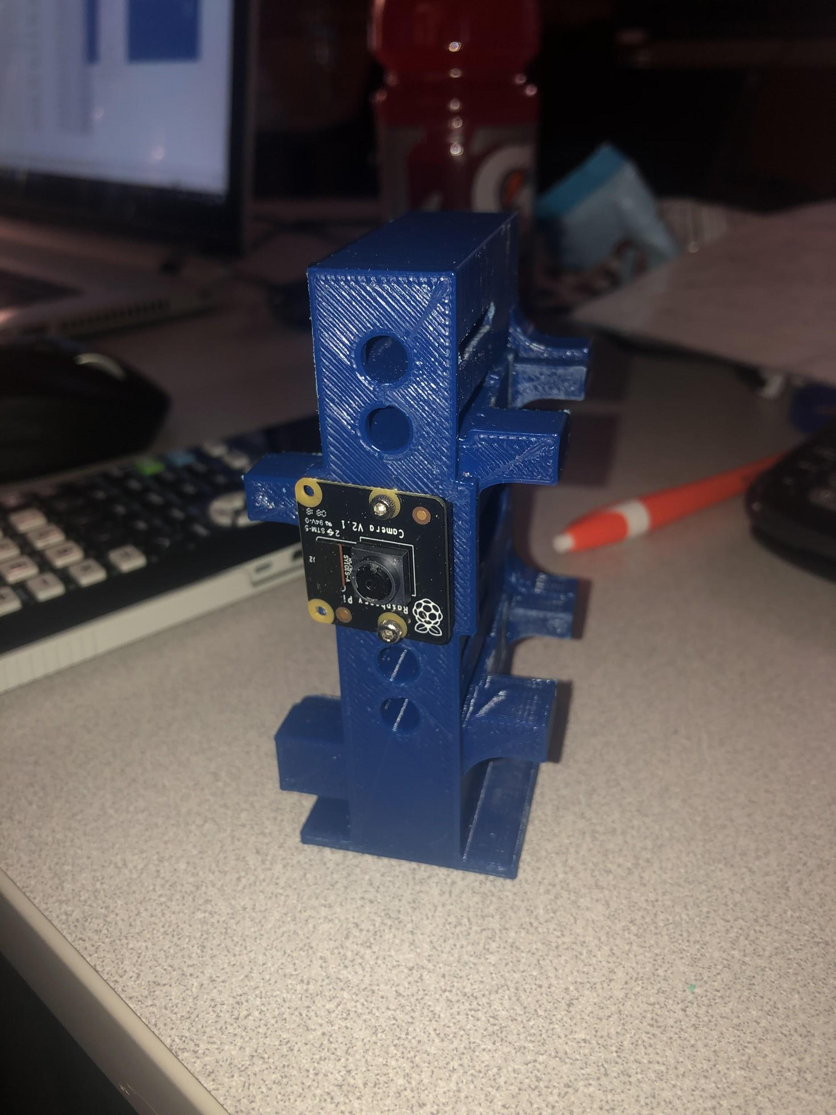
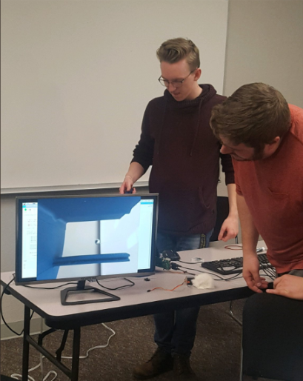
Integrated Subsystem Testing
Testing has been conducted on the launcher structure and the charging mechanism. Fine tuning to optimize the charge time even more between launch.
View from integrated camera
Debris moving in charge field
Charge plate location
Testing with the launcher structure and the mounted camera has been completely. The test was successful in providing coordinates of the debris in the charge field.
Debris launch barrel
Camera mounted to launcher tower

Slide 47
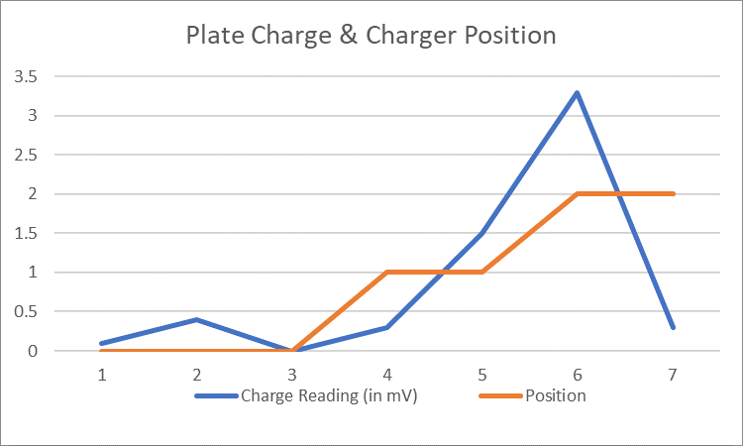
Integrated Subsystem Testing
When integrating the charging plate, charging roller, and debris samples, we found the ideal positioning of the charging apparatus to be completely away from the charging plate. This was when the voltage spiked the most, causing a moment of highest attraction for the aluminum debris.

Slide 48
Integrated Subsystems Testing - Future Integration
Primary Subsystems + Secondary Subsystems + Electronics + Software
Primary Systems + Software + Electrical
Secondary Systems +Software + Electrical
Primary Launcher +Camera
Charging plate + Charging Apparatus
Thermal Sensors + 3D Materials
Electrical+Software + Thermal Sensors

Slide 49
3.0 Electrical
Design Overview, Subsystem Testing and Integrated Subsystem Testing Status
Ryan Wade
Notes:
Those responsible for presenting:
Those responsible for content:
Notes:

Slide 50
Functional Block Diagram (Electrical)

Slide 51
Hazardous Electrical Items
Moderate value capacitor (~1000 uF) on secondary experiment that may be hazardous if touched while charged.
Not a serious concern as it is quickly (<1s) discharged once power is disconnected.
Battery for secondary experiment may be hazardous (3.8V 2Ahr LiPo battery).
With proper insulation and mounting the hazard can be eliminated.
Notes:
Those responsible for presenting:
Those responsible for content:
Notes:

Slide 52
Electrical Testing Status
TEST NAME | DATE | DESCRIPTION OF TEST | SUCCESSES/FAILS | FUTURE PLANS
Thermal testing for heat sinks | 03-28-19 | Test will be conducted by submitting the test product in the expected temperature | This had not been tested on a full scale | Testing before and after being within a vacuum
Telemetry Output | 3-19-19 | To ensure that the telemetry interface is functional and working correctly | Data successfully transferred through RS232 | Verify that operating system is 100% reliable
Battery Switch | 03-10-19 | To test the switch between Wallops power and on-board battery power. | Battery Voltage (3.3V)was too low | Send 5V to Teensy with a buck boost IC
I2C Interface Between Motherboards | 03-25-19 (Spring Break) | To ensure that the data is being successfully transfered | Code has been completed, but is yet to be tested | Test I2C interface between motherboards
Notes:
Responsible: Audrey and Rhiannon

Slide 53
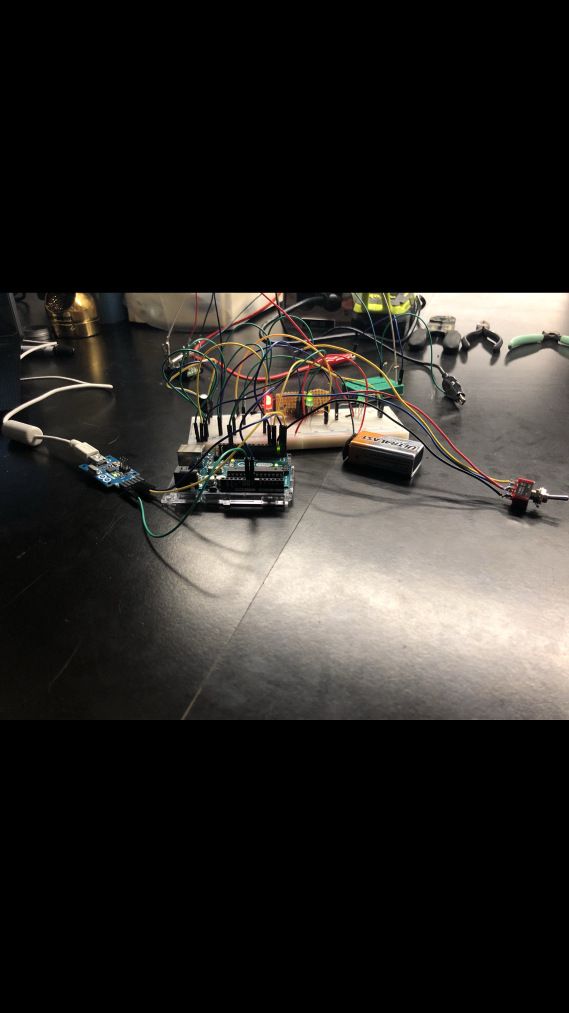
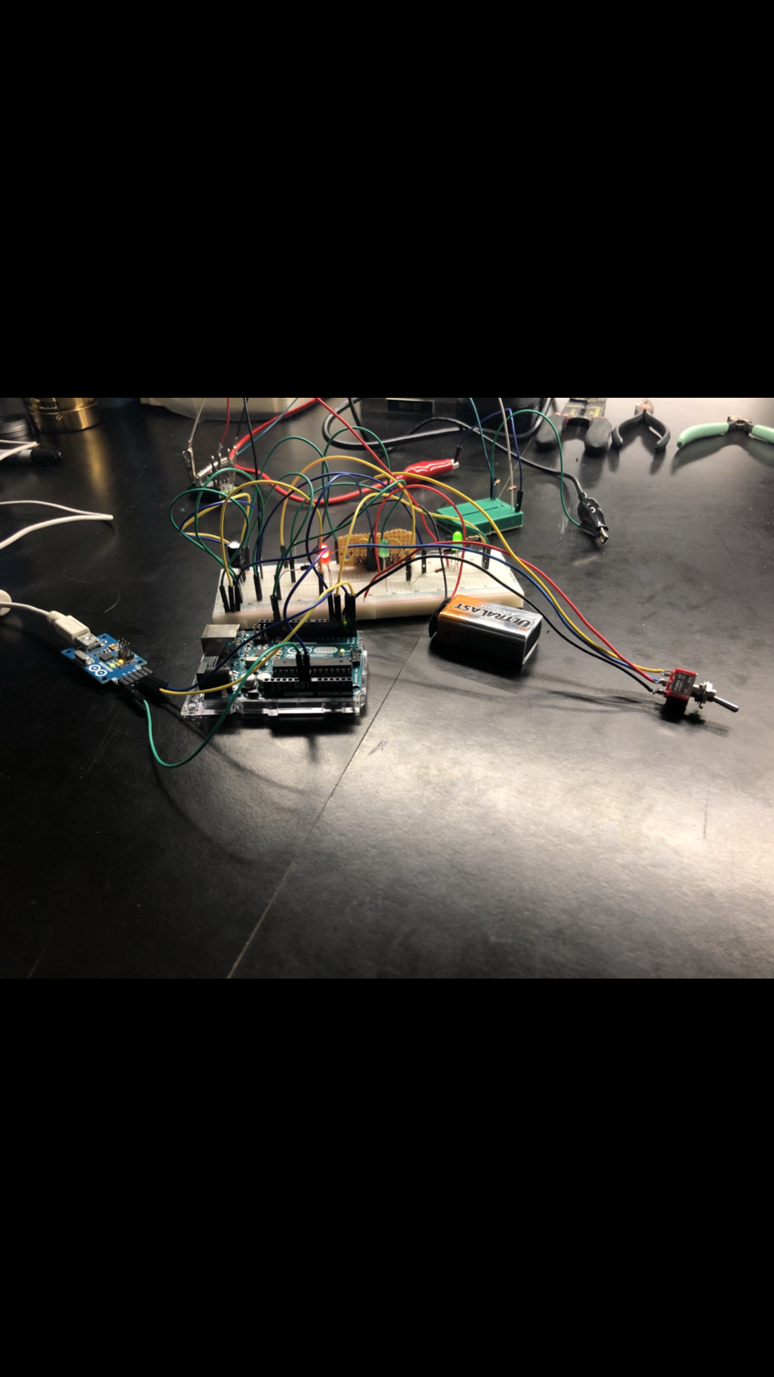
Electrical Interfaces
Rocket Power simulator:
Red LED indicates that power is being transmitted through the arduino and acts as a simulated load
Right most green LED represents the power (28 V) that is being stepped down to power the experiment
Switch off to battery for secondary experiment:
Red LED still continues to indicate that there is voltage through the circuit
Leftmost green LED shows that power is now being obtained 100% from the battery and no longer from the rocket supply
Notes:
Those responsible for presenting:
Those responsible for content:
Notes:

Slide 54
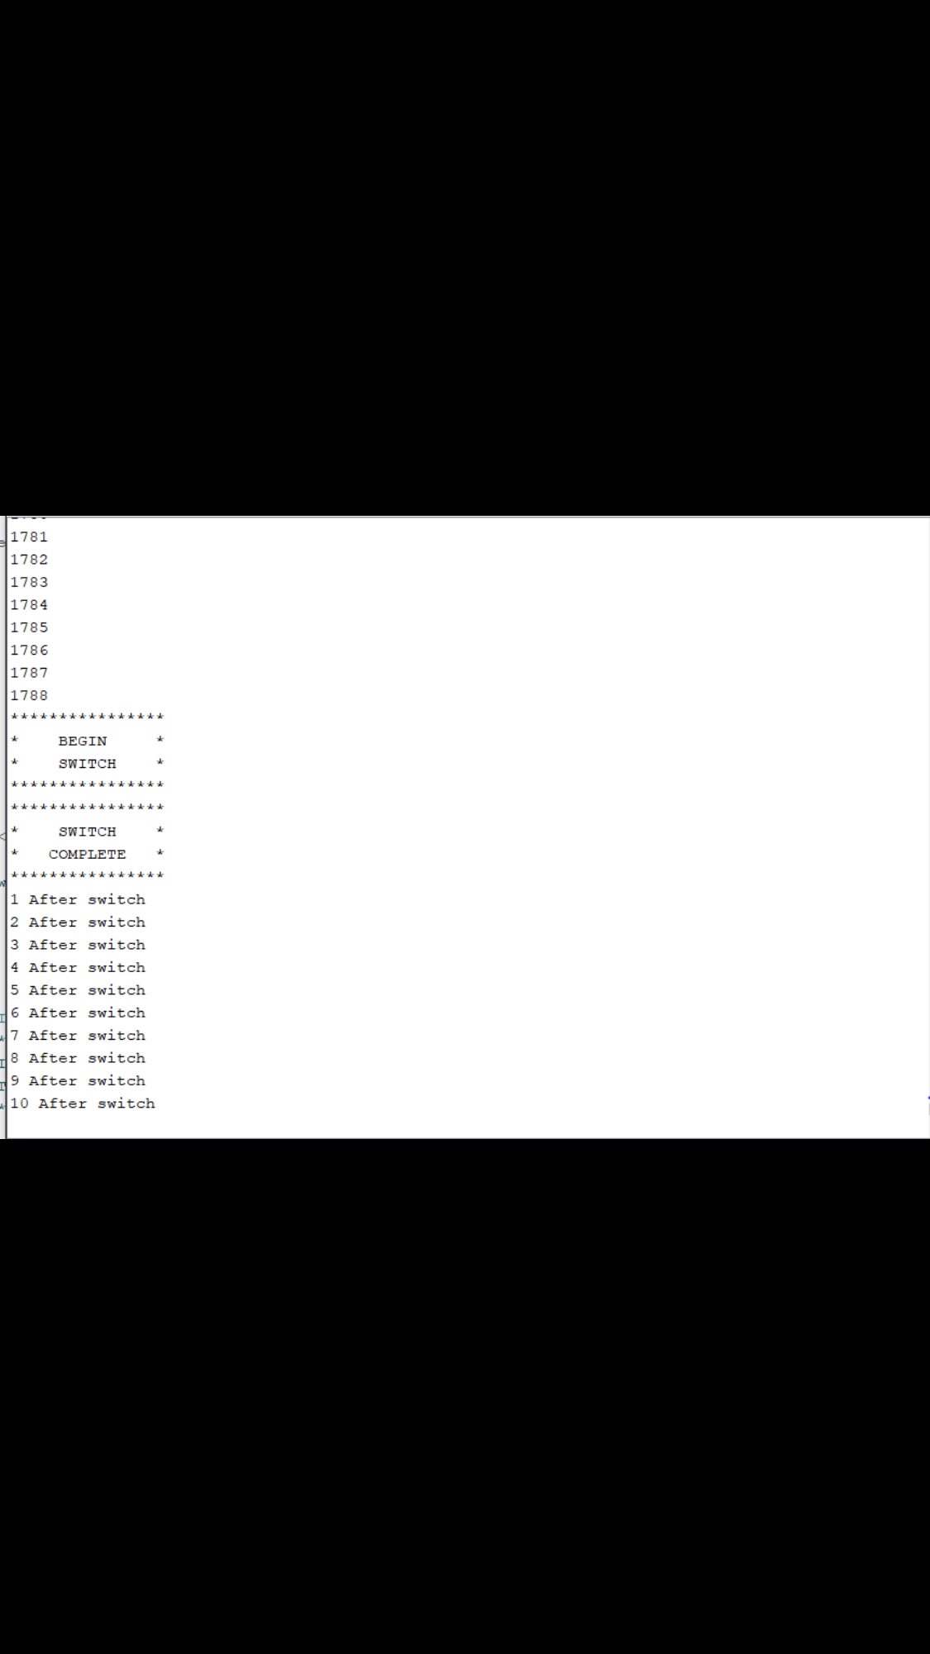
Telemetry Asynchronous RS-232 Interface
Indicates that we are receiving signal and data is being received
Time between power switch, display will verify that we have has a successful power switchover.
Logic and output continues to function after switchover until battery has been signaled to terminate
Notes:
Those responsible for presenting:
Those responsible for content:
Notes:

Slide 55
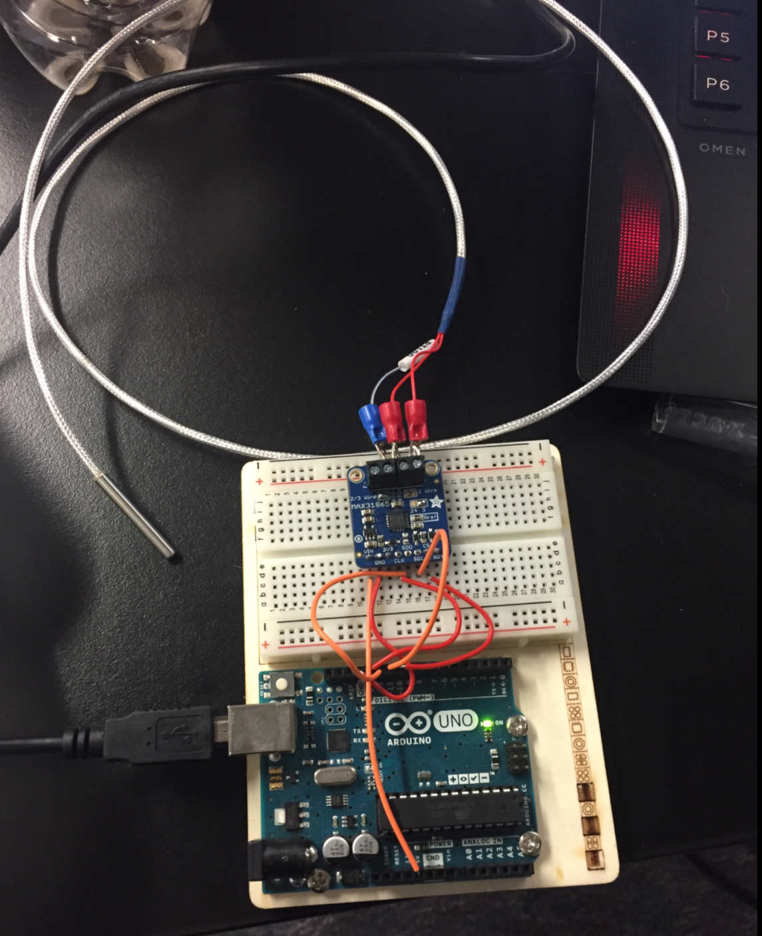
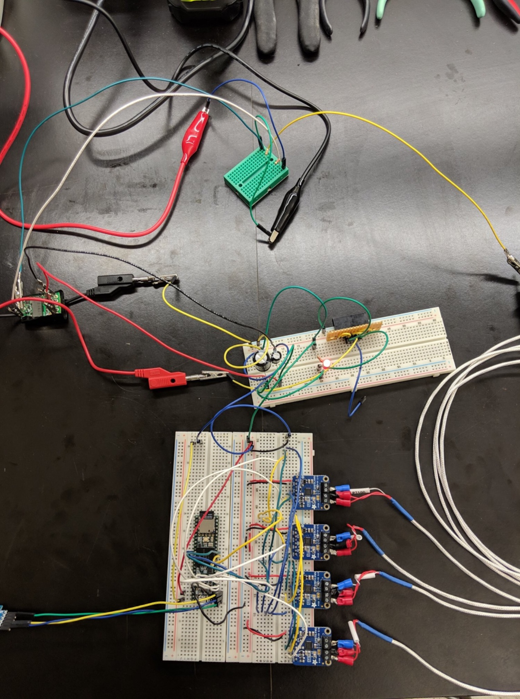




Electrical
MAX31865 + RTD P100 probe testing
Secondary experiment power supply testing
Secondary Experiment
Telemetry Interface
Prototype RS-232 Interface
RS-232 output
Current draw (at 3.3v) of one MAX31865 breakout
Forge Temperature Meter

Slide 56

Primary Experiment: Schematics

Slide 57



Primary Experiment: PCB board (80%)
All of our components will be plated through hole or surface mount.
Everything is to scale which allows us to test fit on paper prints while implementing everything as if it were the final product.

Slide 58

Secondary Experiment: Schematics

Slide 59



Secondary Experiment: PCB board (80%)
All of our components will be plated through hole or surface mount.
Everything is to scale which allows us to test fit on paper prints while implementing everything as if it were the final product.

Slide 60
4.0 Software
Design Overview, Subsystem Testing and Integrated Subsystem Testing Status
Ian McComas
Notes:
Those responsible for presenting:
Those responsible for content:
Notes:

Slide 61


Functional Block Diagram (Software)
Notes:
Those responsible for presenting:
Those responsible for content: Ethan or James
Notes:

Slide 62

Software Coding Block Diagram (Photo-Recognition for Telemetry)

Slide 63

Functional Block Diagram (Software Secondary)
Notes:
Those responsible for presenting:
Those responsible for content:
Notes:

Slide 64
Subsystem Testing(Software Primary Completed 75%)
Camera Tests (Completed)
Pi Zero implemented with image processing code.
Pi Zero drops frames from video feed when pulling single frames for processing.
Packaging for telemetry narrowed down.
Averaging X,Y components in image and saving number of pixels affected.
Realized end of “hallway” was exposed to changing features in image background.
Decided to add deflection plate to mitigate noise.
Full Servo/Motor setup
All servos and motors run off one board.
Testing resulted in systems performing as intended.

Slide 65
Subsystem Testing(Software Primary Incomplete 25%)
Camera (To Be Tested)
Proposed solution to frame skipping is to process the images post recording.
Recording will be done in 20 second segments between launch iterations.
Approximately 5 seconds will be allocated to processing time while plate is charging.
Implementation of I2C bus is still in development.
I2C Bus (In development)
Arduino has been assigned master protocols.
Pi has been assigned slave protocols.
Pi has shown difficulty communicating with arduino master board.
A work around for this is currently being considered and is planned for testing soon.

Slide 66
Subsystem Testing(Software Secondary 90%)
Secondary software tests are 90% complete
Completed
Reading Multiple Temperature Probes
Writing Temperature data to an SD card
Writing Temperature from slave to master through i2c communication
Yet to be tested
Code for power transfer has yet to be tested on the actual thermal system.

Slide 67
5.0 Plan for Full Mission Simulation Review (FMSR)
Bruce Bell

Slide 68
Mechanical Testing (Primary)
Launching Mechanism
Needs to be tested in environmental conditions.
Shake Table and Stress analysis to ensure that it will survive ascend.
Multiple trials will be conducted to ensure that the debris velocity and alignment are accurate and replicable each time.
An enclosure for wiring may need to be added to help isolate and protect components and data. Further environmental testing will be conducted to determine if this is necessary.
Testing of the items above will be completed on or before April 1, 2019
No mechanical inhibitors will be used, the inhibitors will be implemented through code.
Notes:
Those responsible for presenting:
Those responsible for content: Dallas
Notes:

Slide 69
Mechanical Testing (Primary)
Charging Mechanism
Due to slight design change, additional testing is required to ensure that the design is replicable and produces consistent electric fields.
Environmental testing needs to be conducted on this subsystem.
Shake and stress testing will be conducted to ensure that the motor placement and polycarbonate sheet is secured, stable and will survive ascend.
Further vacuum testing will be conducted to ensure replicability.
Testing of the items above will be completed on or before April 1, 2019
No mechanical inhibitors will be used, the inhibitors will be implemented through code.
Notes:
Those responsible for presenting:
Those responsible for content: Dallas
Notes:

Slide 70
Mechanical Testing (Secondary)
Mounting Mechanism
Further environmental testing needs to be conducted
Shake and stress testing will be conducted to ensure that the wall and prints are adequately mounted to survive ascend.
Additional heating, cooling and wind testing will be conducted to ensure that the fiberglass plate protects the prints from dismount due to high heat and that wall is secure.
Testing of the items above will be completed on or before April 1, 2019
No mechanical inhibitors will be used, the inhibitors will be implemented through code.
Notes:
Those responsible for presenting:
Those responsible for content: Dallas
Notes:

Slide 71
Electrical Testing: Primary Experiment
Further environmental testing will be conducted.
Shake testing will ensure that the components and soldering are durable and secure for flight
Full scale vacuum testing will be conducted to ensure no arcing from the static charge generation system as well as our control boards.
All electronic components will be closely inspected and tested to ensure there is no bridging of the solder or thermal damage from soldering.
All electronic boards will be conformally coated to protect the components from arching or collecting hazardous material.
The items listed above will be tested and completed during the first week of April
Notes:
Those responsible for presenting:
Those responsible for content: Ryan (electrical team)
Notes:

Slide 72
Electrical Testing: Second Experiment
Switching from provided power to secondary power must be tested on a full scale level with all subsystems.
Safety and reliability of LiPo battery
Safety and reliability of capacitor
All wiring insulation must be tested to ensure safety and reliability of signal transfer.
The items listed above will be tested and completed during the first week of April
Notes:
Those responsible for presenting:
Those responsible for content: Henry
Notes:

Slide 73
Software Testing: Primary
Primary
Taking blocks of saved footage from cameras and processing those images.
This is being done to remove video skipping, leaving video data pristine.
Final implementation of I2C bus and connection of all boards.
With the completion of this task all of primary’s software will be complete.
Secondary
Remaining code to be tested is the code for the power transfer.
Code has been written, but has yet to be implemented and tested.
All testing above is to be completed: March 27th - April 2nd
Notes:
Those responsible for presenting:
Those responsible for content: Ian
Notes:

Slide 74
System Level Testing (Mechanical)
Full scale environmental testing needs to be conducted
Heating, cooling and wind tests will ensure that all components will survive the effects of re-entry.
Shake, stress and strain test will ensure that all components will survive the effects of flight.
Vacuum testing will ensure that all components will operate and function at apogee.
The timing of launch will be tested and slightly adjusted to ensure that the debris is launched when the static charge field is at its peak for maximum results.
Tests to be conducted during the first week of April

Slide 75
System Level Testing (Electrical)
Verify that the PCB’s for both primary and secondary experiments are functioning and relaying the expected results.
Transmission of telemetry based on the information that is being obtained by our temperature probes as well as video streaming and captured images.
Mission simulation code has been created in order to further the depth of testing that is and will continue to be done.
Further testing of power swap will be conducted to ensure that the secondary experiment has successful startup before descend.
Tests to be conducted during the first week of April
Notes:
Content: Ruby

Slide 76
System Level Testing (Software)
Further testing of the camera and image recognition software will be conducted to ensure that the results are consistent.
Timing of the servo for debris launch will continue to be conducted to ensure that the desired debris velocity is repeatable for all four trials.
Timing of the servo and motor for the static charge generator will be conducted to ensure that the positioning of the charging apparatus is at the desired position for maximum results.
Software testing of power swap will be conducted to ensure that the secondary experiment will have power during re-entry.
Tests to be conducted during the first week of April

Slide 77
Plan for FMSR
To ensure the subsystems are fully integrated for the FMSR:
Potential future issues will be studied and eliminated.
Full testing will continue.
We will perform a full mission simulation to verify that all components are working accurately and adequately.
No major hurdles are anticipated.
Notes:
Those responsible for presenting:
Those responsible for content: Audrey
Notes:

Slide 78
6.0 Project Schedule
Cassidy Bliss

Slide 79
April Schedule
Friday
Saturday
Friday
Saturday
Friday
Friday
Friday
05
06
12
13
22
System Integration Day 1
System Integration Day 2
Vibration Testing Individual Subsystems
Vibration Testing Complete Integrated Systems
Full Mission Simulation Review (FMSR)
Notes:
Those responsible for presenting:
Those responsible for content: Stacie
Notes:

Slide 80
May Schedule
Friday
Friday
Friday
Friday
Friday
Friday
Friday
03
10
17
24
31
Final Subsystem Testing
Final Complete Integrated System Testing
Full team: go over any final design changes
Complete any final design changes
Integration including any final design changes

Slide 81
June Schedule
Saturday
Friday
Friday
Monday
Friday
Friday
Friday
01
07
14
17
21
Last day to do ANY design Adjustments
Integration Readiness Review (IRR)
Full team: Get ready for Integration Week
Integration Week!!

Slide 82
June Operations: Overview
Final payload with all systems fully functional will be present for testing.
An inhibit pin will be used for the majority of testing to prevent object release and battery latching.
Inhibit pin will still allow for battery latching for a significantly shortened duration to preserve battery charge for full mission simulation on final test.
Inhibit pin will be removed before final post vibe test allowing for a full mission simulation with full battery test.
Notes:
Those responsible for presenting:
Those responsible for content:
Notes:

Slide 83
June Operations
The effects of microgravity will not be able to be tested from the ground in regard to its role on the primary experiment.
The exact conditions of re-entry can be simulated from the ground to a certain degree, but cannot be truly replicated for our secondary experiment to measure the effects of re-entry on the 3D printed materials.
Notes:
Those responsible for presenting:
Those responsible for content:
Notes:

Slide 84
7.0 Project Management
Ruby Martinez Gomez

Slide 85


Update on Partnerships
In effort to fund our teams travel to Wallops this summer, we are utilizing multiple platforms for engaging community partners and fundraising:
We have drafted personalized letters to a variety of Colorado-based aerospace companies seeking donations. We are showcasing our diversity and inclusivity in hopes of reaching a broader market.

Slide 86


Update on Fundraising
Our team organized and staffed a concert at the Mercury Cafe in Denver which allowed us to raise $600. This event displayed music as well as our current experiment and last year's CCofCO experiment.
Notes:
Those responsible for presenting:
Those responsible for content: Ruby
Notes:

Slide 87
Payload Special Operations/Inhibits
No special operations or inhibits are needed for either of our experiments to operate the payload.
Notes:
Those responsible for presenting:
Those responsible for content: Joseph
Notes: Primary and secondary

Slide 88
User Guide Compliance: Summary
Requirement | Status/Reason (if needed)
Center of gravity in 1" plane of plate? | YES (2cm)
Weight 15.0 +/- 0.5 lbs? | YES (~11lbs)
Max Height < 5.13” | 5”
Bottom of deck has flush mount hardware? | YES
Within Keep-Out Zone | NO
Using < 10 A/D Lines | 0
Using/Understand Parallel Line | N/A
Using/Understand Asynchronous Line | YES
Using X GSE Line(s) | 1
Using X Non-Redundant PWR Lines (TE-1, TE-2, TE-3) | 1
Using X Redundant Power Lines (TE-R) | 1
Using < 1 Ah (< 0.5 Ah for half payload) | YES
Using <= 28 V | YES
Using RF (If yes, list frequency and TX Power) | NO
Using deployable? | YES
Whole team consists of US Persons | YES
Using ITAR and/or Export Controlled hardware | NO
2019
Notes:
Those responsible for presenting:
Those responsible for content: DONE
Notes:

Slide 89


Monetary Budget
This budget includes:
- Cost of participation
- Hardware expenses
- Budget for travel expenses
- Updated cost per experiment

Slide 90

Team Contact Matrix
Notes:
Those responsible for presenting:
Those responsible for content: Ruby
Notes:

Slide 91

Availability Matrix

Slide 92

Team Picture
From left to right: Bruce Bell, Ruby Martinez, Cassidy Bliss, Dallas McKeough, Henry Reyes, Nick Vail, Ian McComas, Ryan Wade, Joseph Harrell, Rhiannon Larsen, James Cook. Not Shown: Audrey Whitesell, Stacie Barbarick
Notes:
Those responsible for presenting:
Those responsible for content: Ruby
Notes:

Slide 93
8.0 Conclusions

Slide 94
Worries and Concerns
We must ensure that the mechanical system to generate charge is sound, more moving parts leads to a higher risk failure. Testing and high quality components have helped to eliminate this worry.
Positioning the camera in a stable manner, at an optimal data-capture angle, so it will remain focused throughout the experiment. Testing has helped eliminate this concern.
Establishing a precise initial velocity vector within the launch barrel to ensure accurate data regarding any variation in trajectory of the debris samples. Repeated trials, precise code, and data analysis, will mitigate this concern.
Notes:
Those responsible for presenting:
Those responsible for content:
Notes:

Slide 95
Questions and Concerns
When should we expect to receive our experiment deck and electrical connectors?
Notes:
Those responsible for presenting:
Those responsible for content:
Notes:

Slide 96
Appendix

